Slide 1

Project 3 Final Design
Uni-Fy
Eli Goldberg
Vidhi Shah
Kaylie Nguyen

Slide 2
Problem Statement
College students struggle with converting acquaintances into friends and maintain a lasting relationship with friends due to difficult schedules and lack of opportunities to connect with students. Uni-fy would aim at helping students navigate their social life more seamlessly and form meaningful bonds easily.
"How might we…"
How might we help college students in Philadelphia make friends with each other and maintain their friendships at the same time?

Slide 3
Project Goal
We want to research on how satisfied the students are with their social relationships in college, what problems they are facing and help them solve these issues.
By designing a multimedia product, we aim to help college students in Philly connect with each other more easily and expand their social network, while building some tight-knit friendships, so that they can improve their social life better.

Slide 4
How We Got There
Research Process + Findings

Slide 5
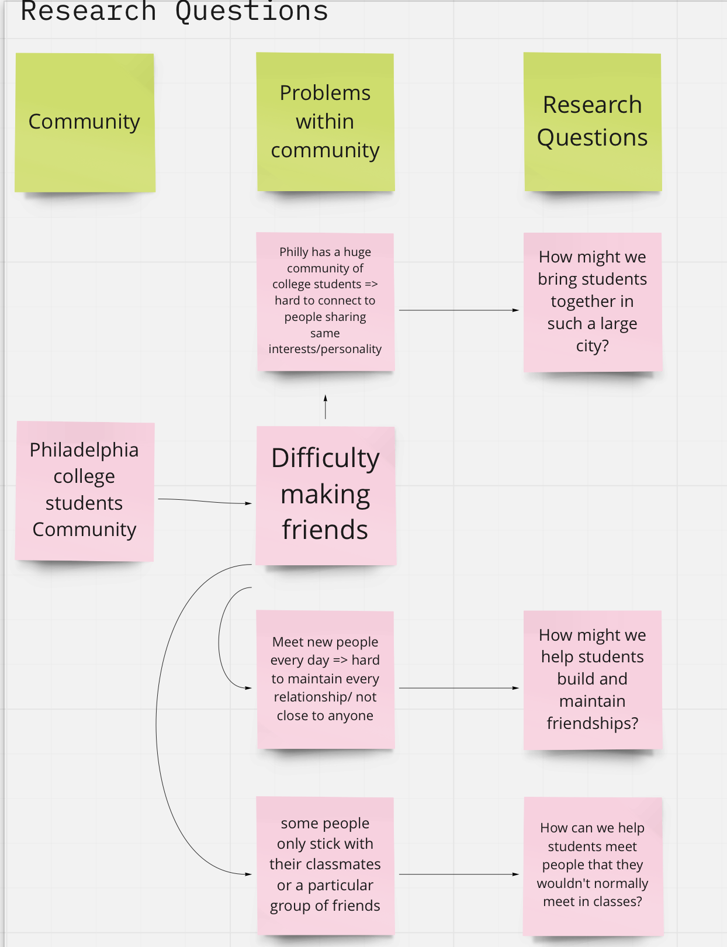
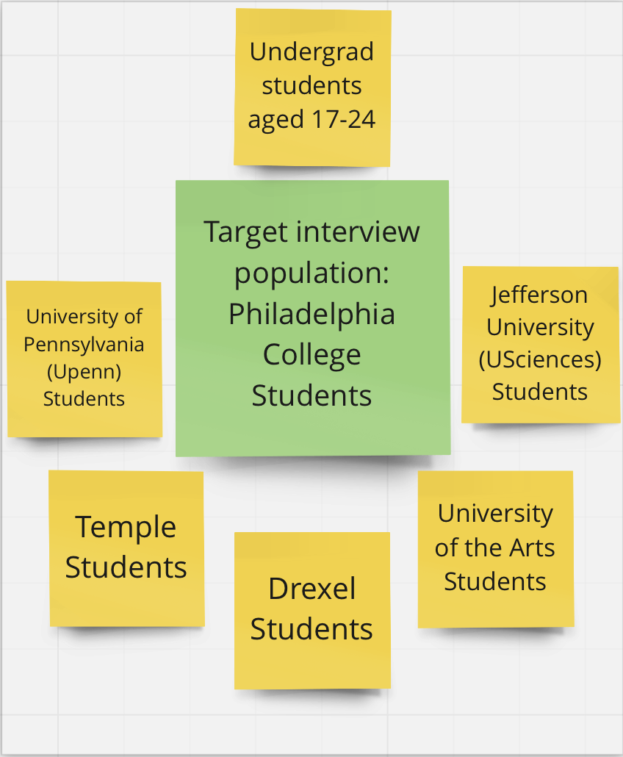
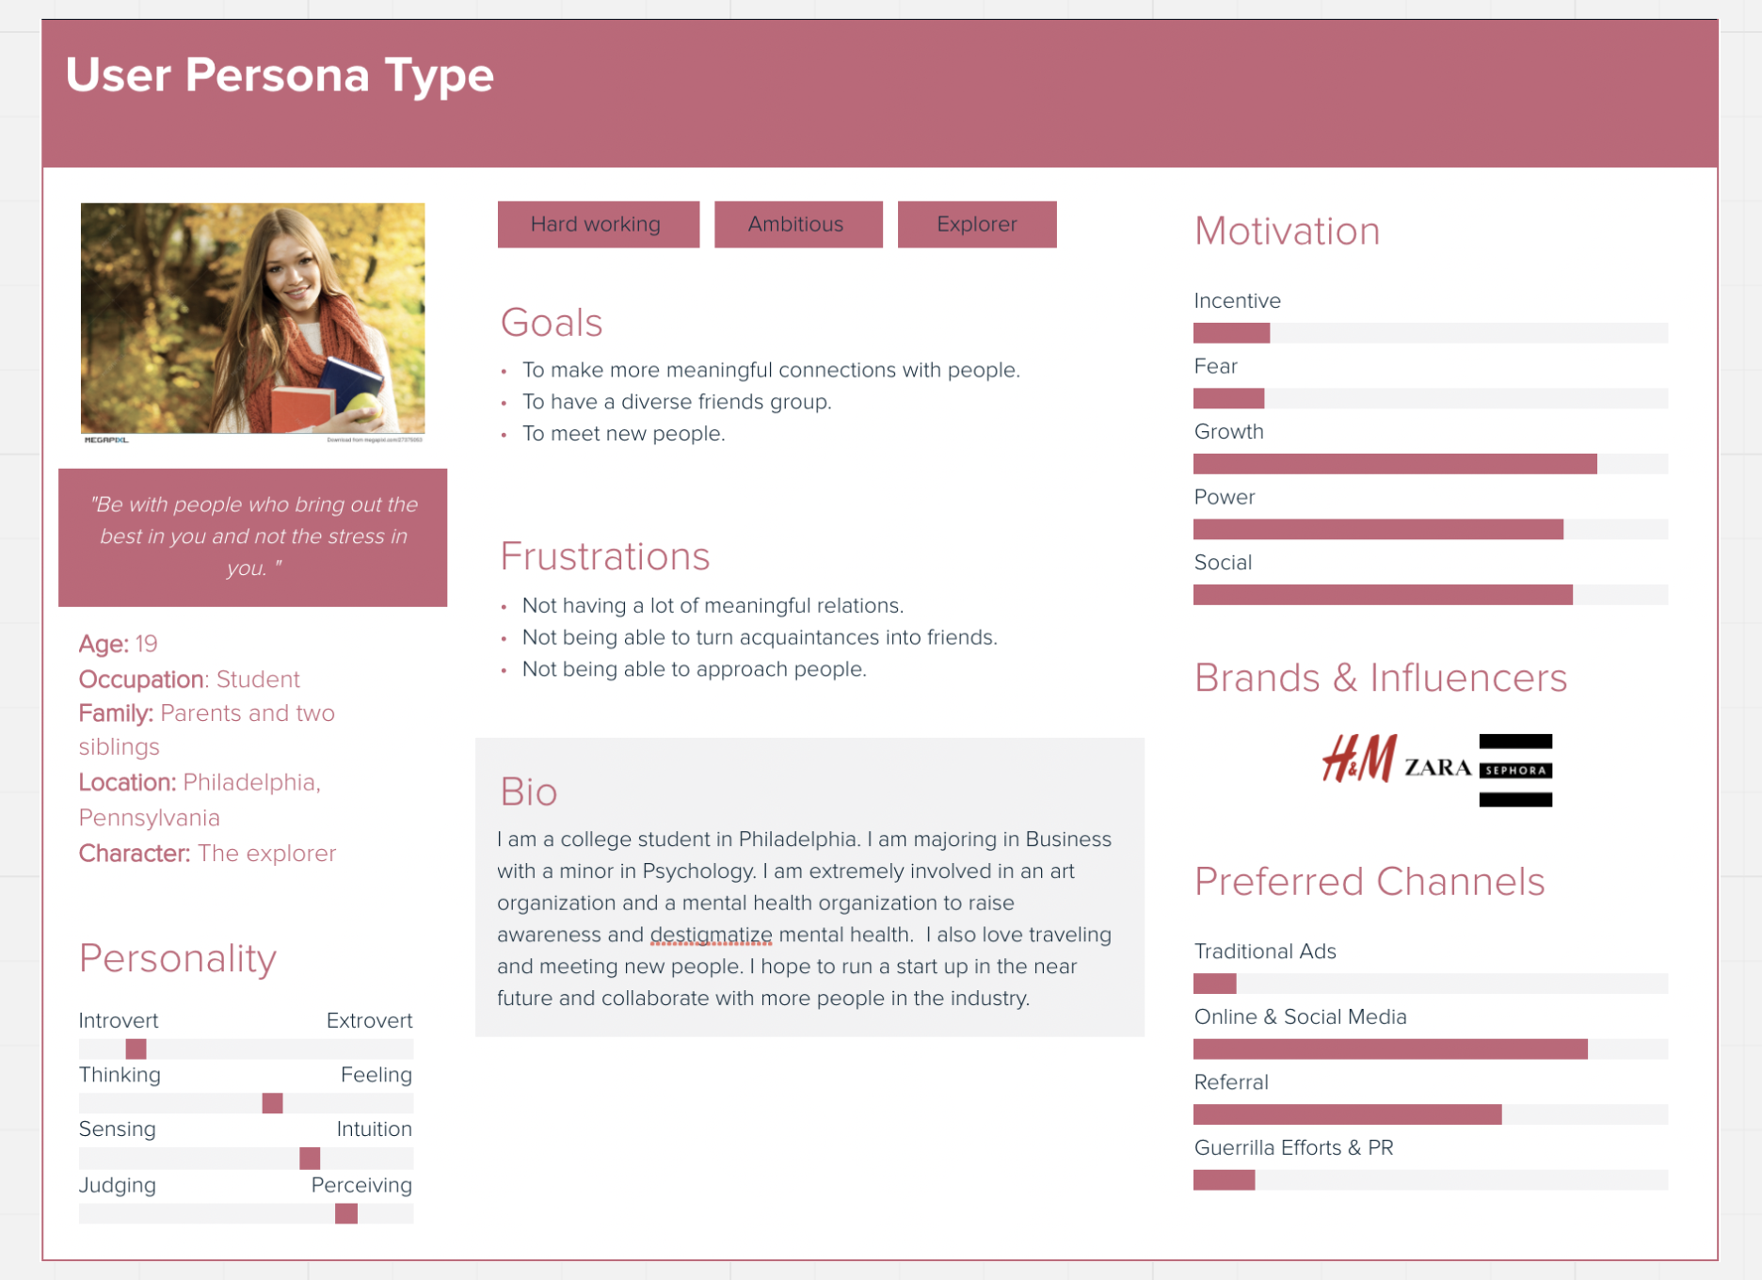
Community and Target Audience
Narrowing down from community to target audience to user persona

Slide 6
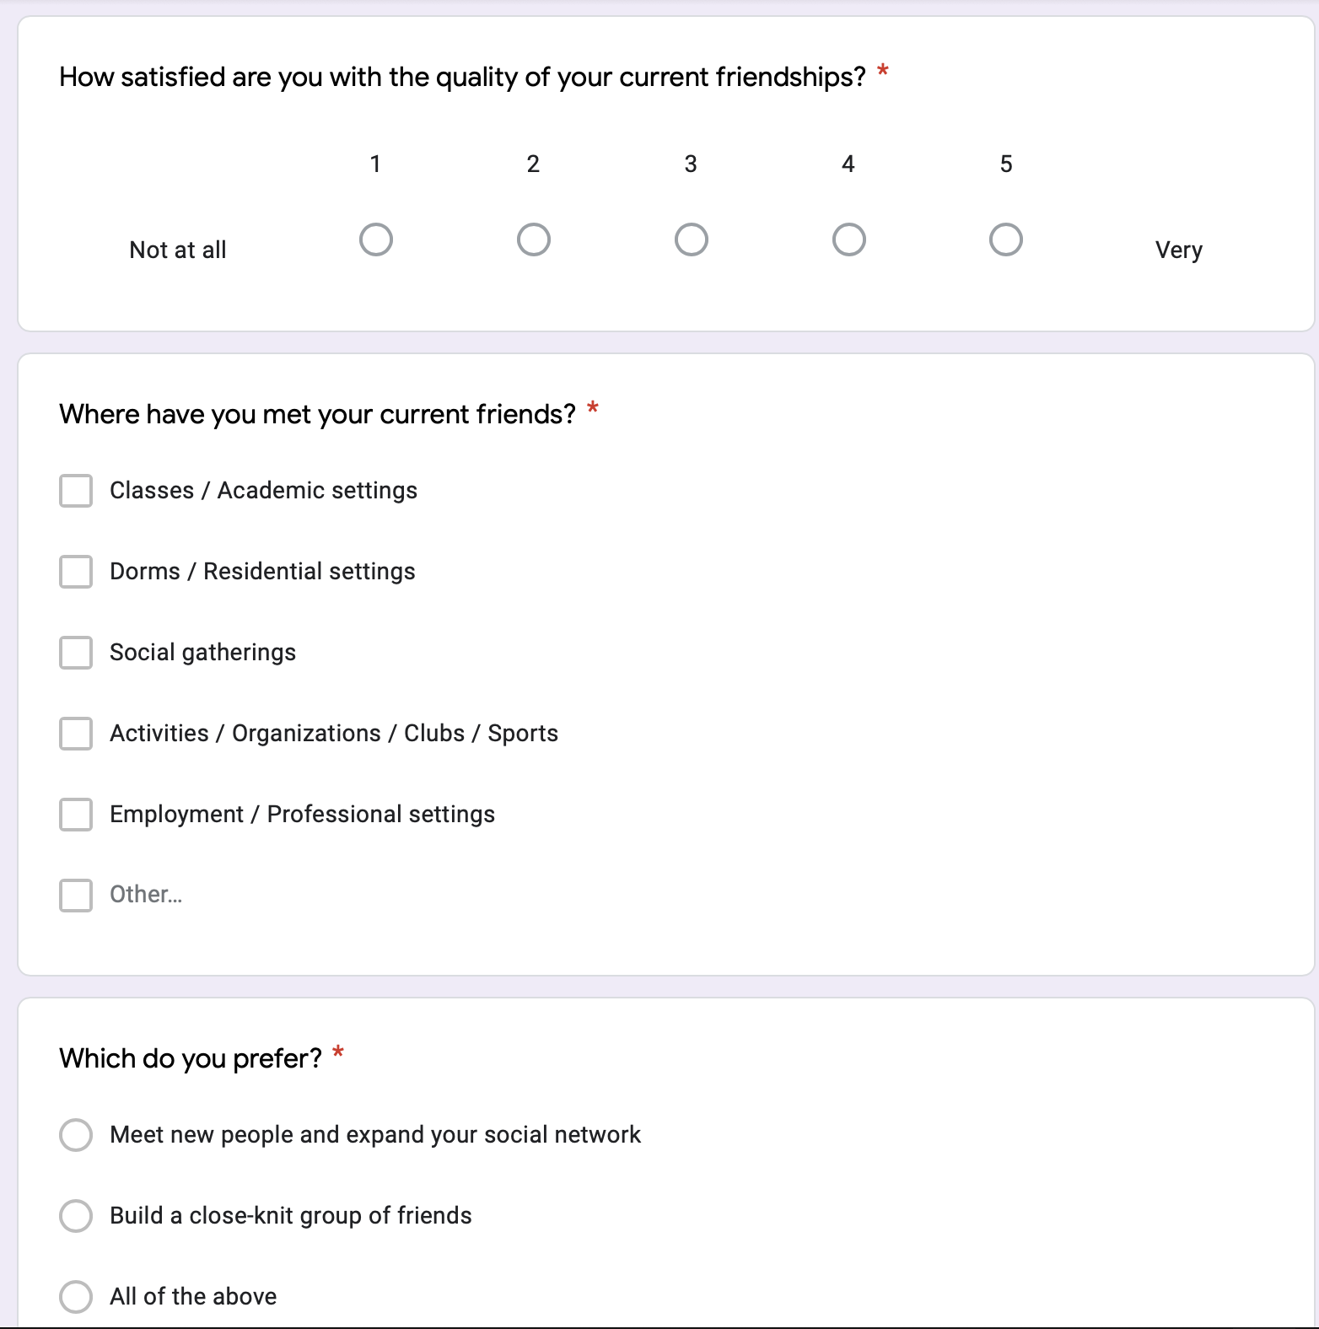
Methods of Research
A brief 13 question survey
Responses from over 25+ Philadelphia undergraduate students
Questions involving friendship observations and opinions

Slide 7
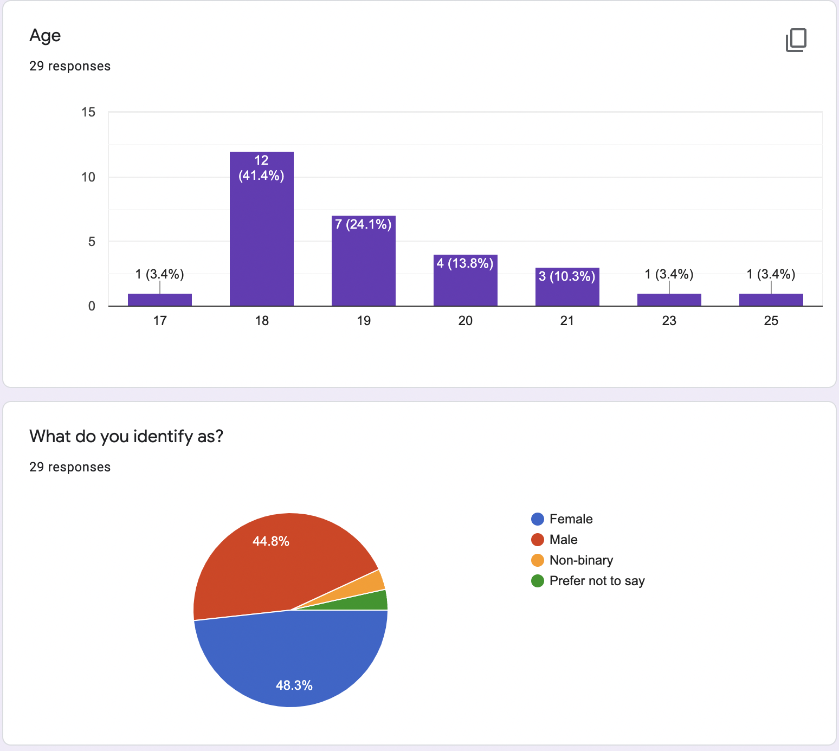
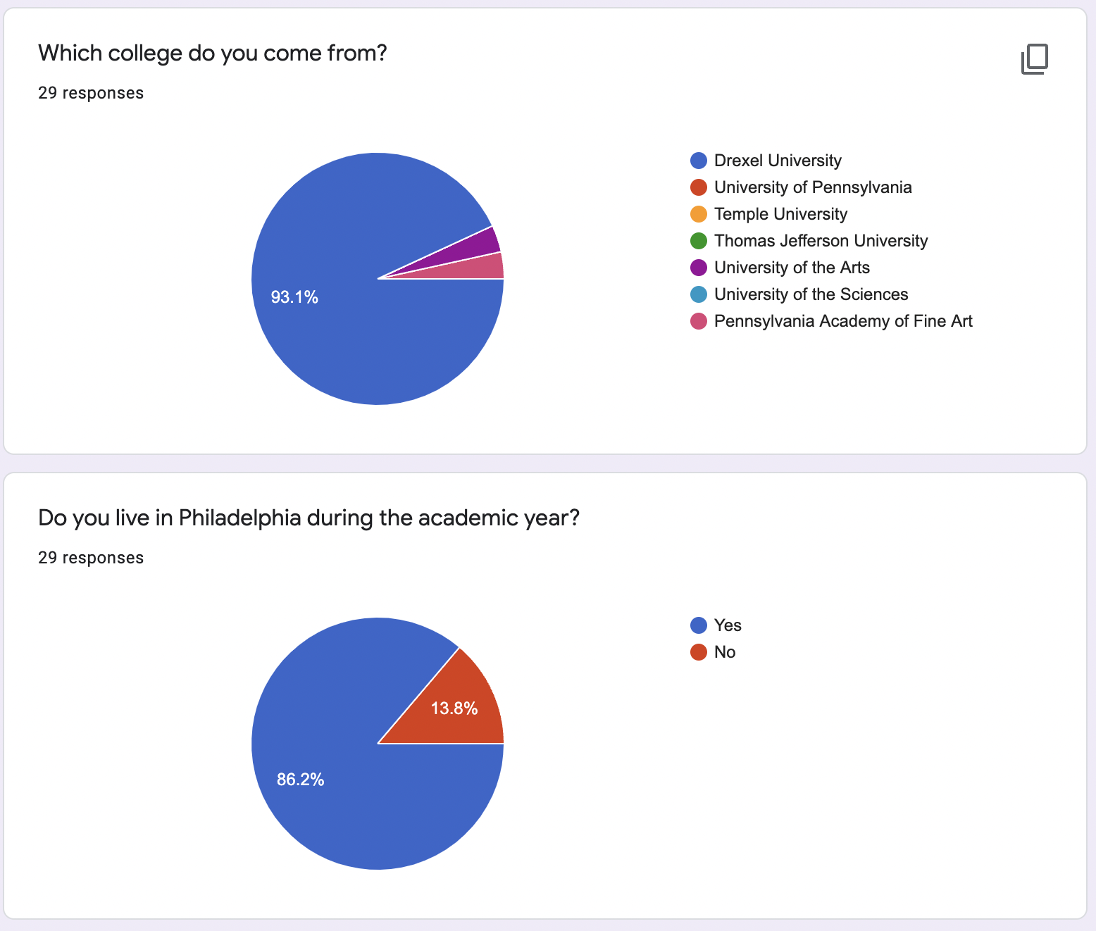
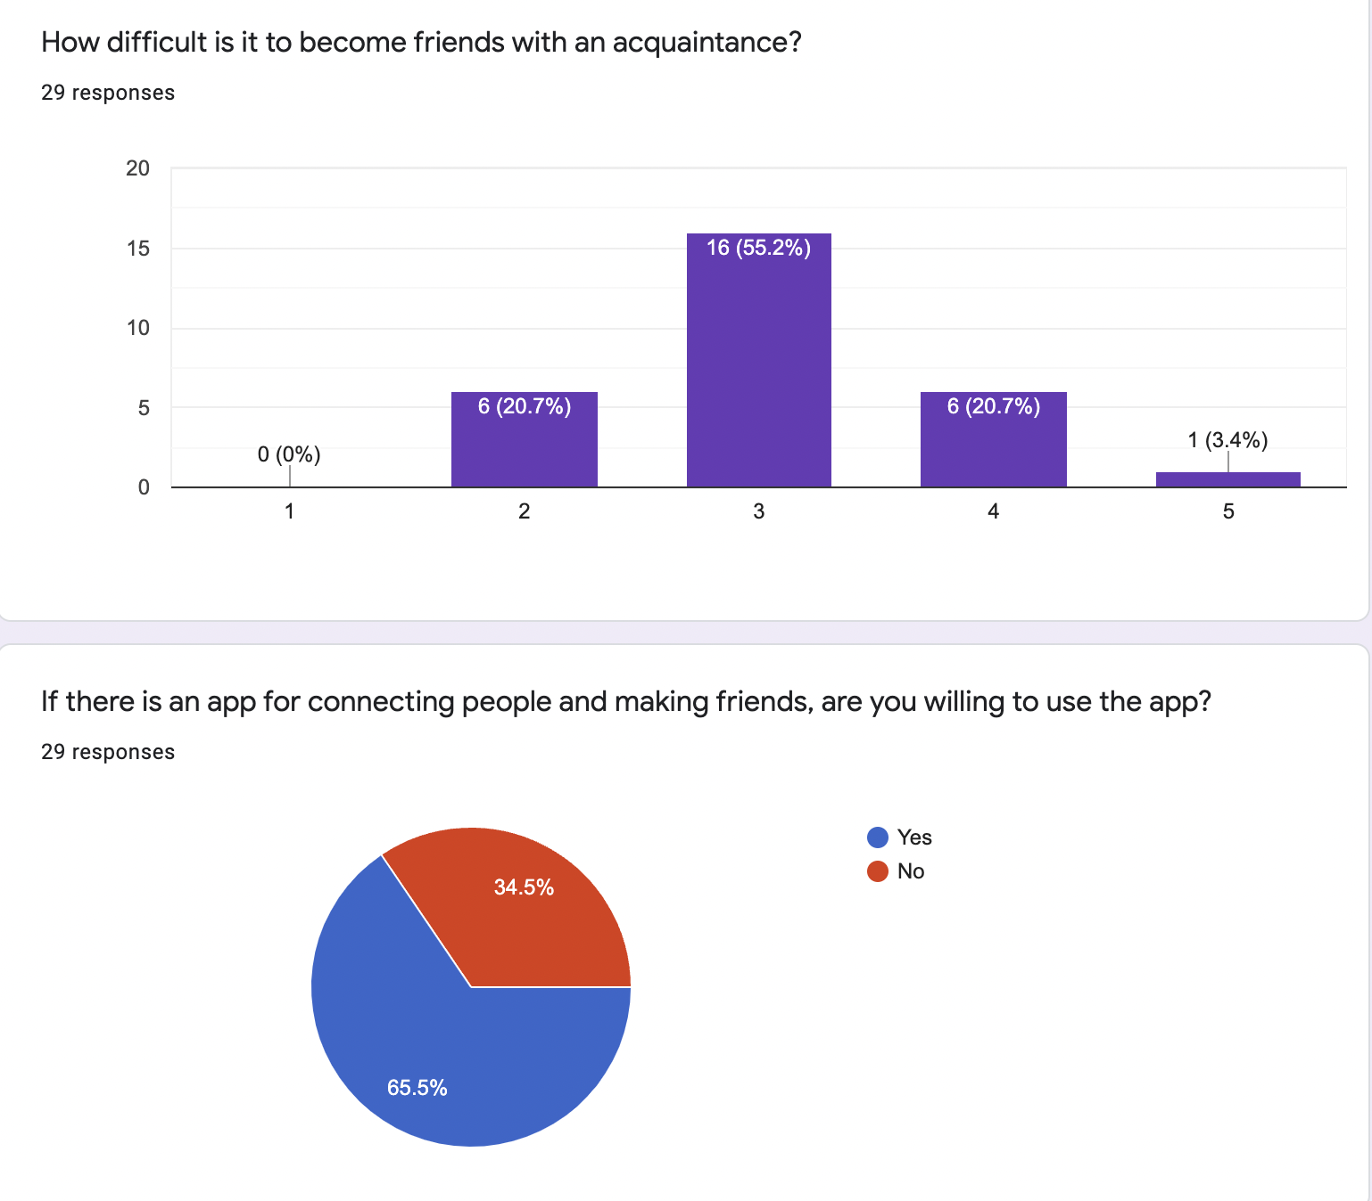
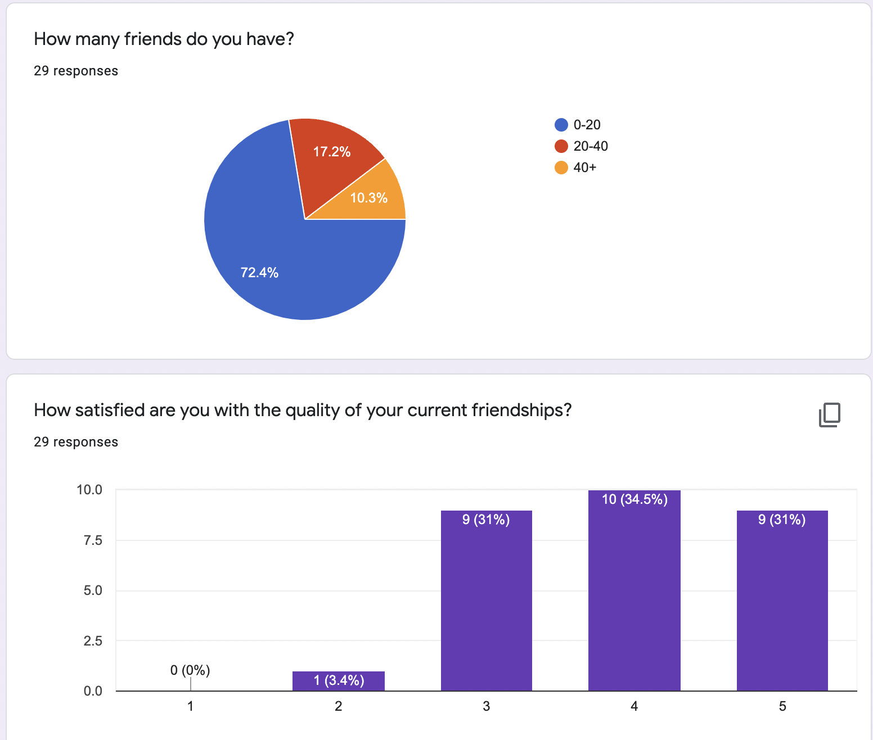
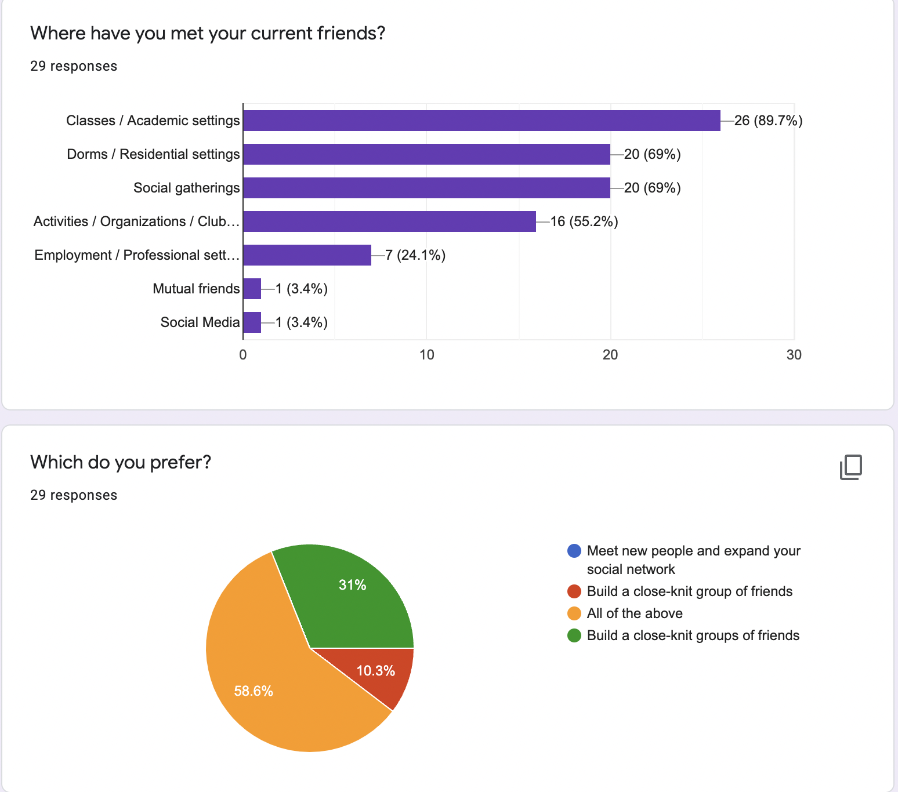
Research Findings
Demographic information
Mostly Drexel Students
Average age range: 18-20
Slightly more female
Demographics – Location & Uni
Friendship information
Moderate difficulty making friends with an acquaintance
Met friends through academic/living/ social settings
Demographics – Age & Gender
Friendship Questions

Slide 8
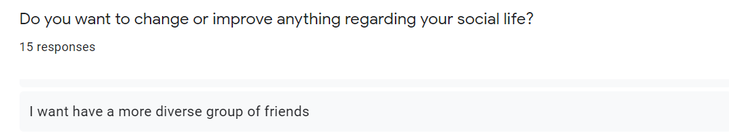
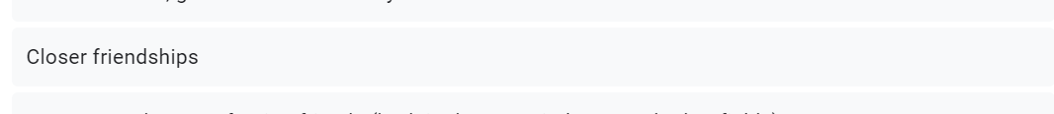
Research Analysis Quotes

Slide 9
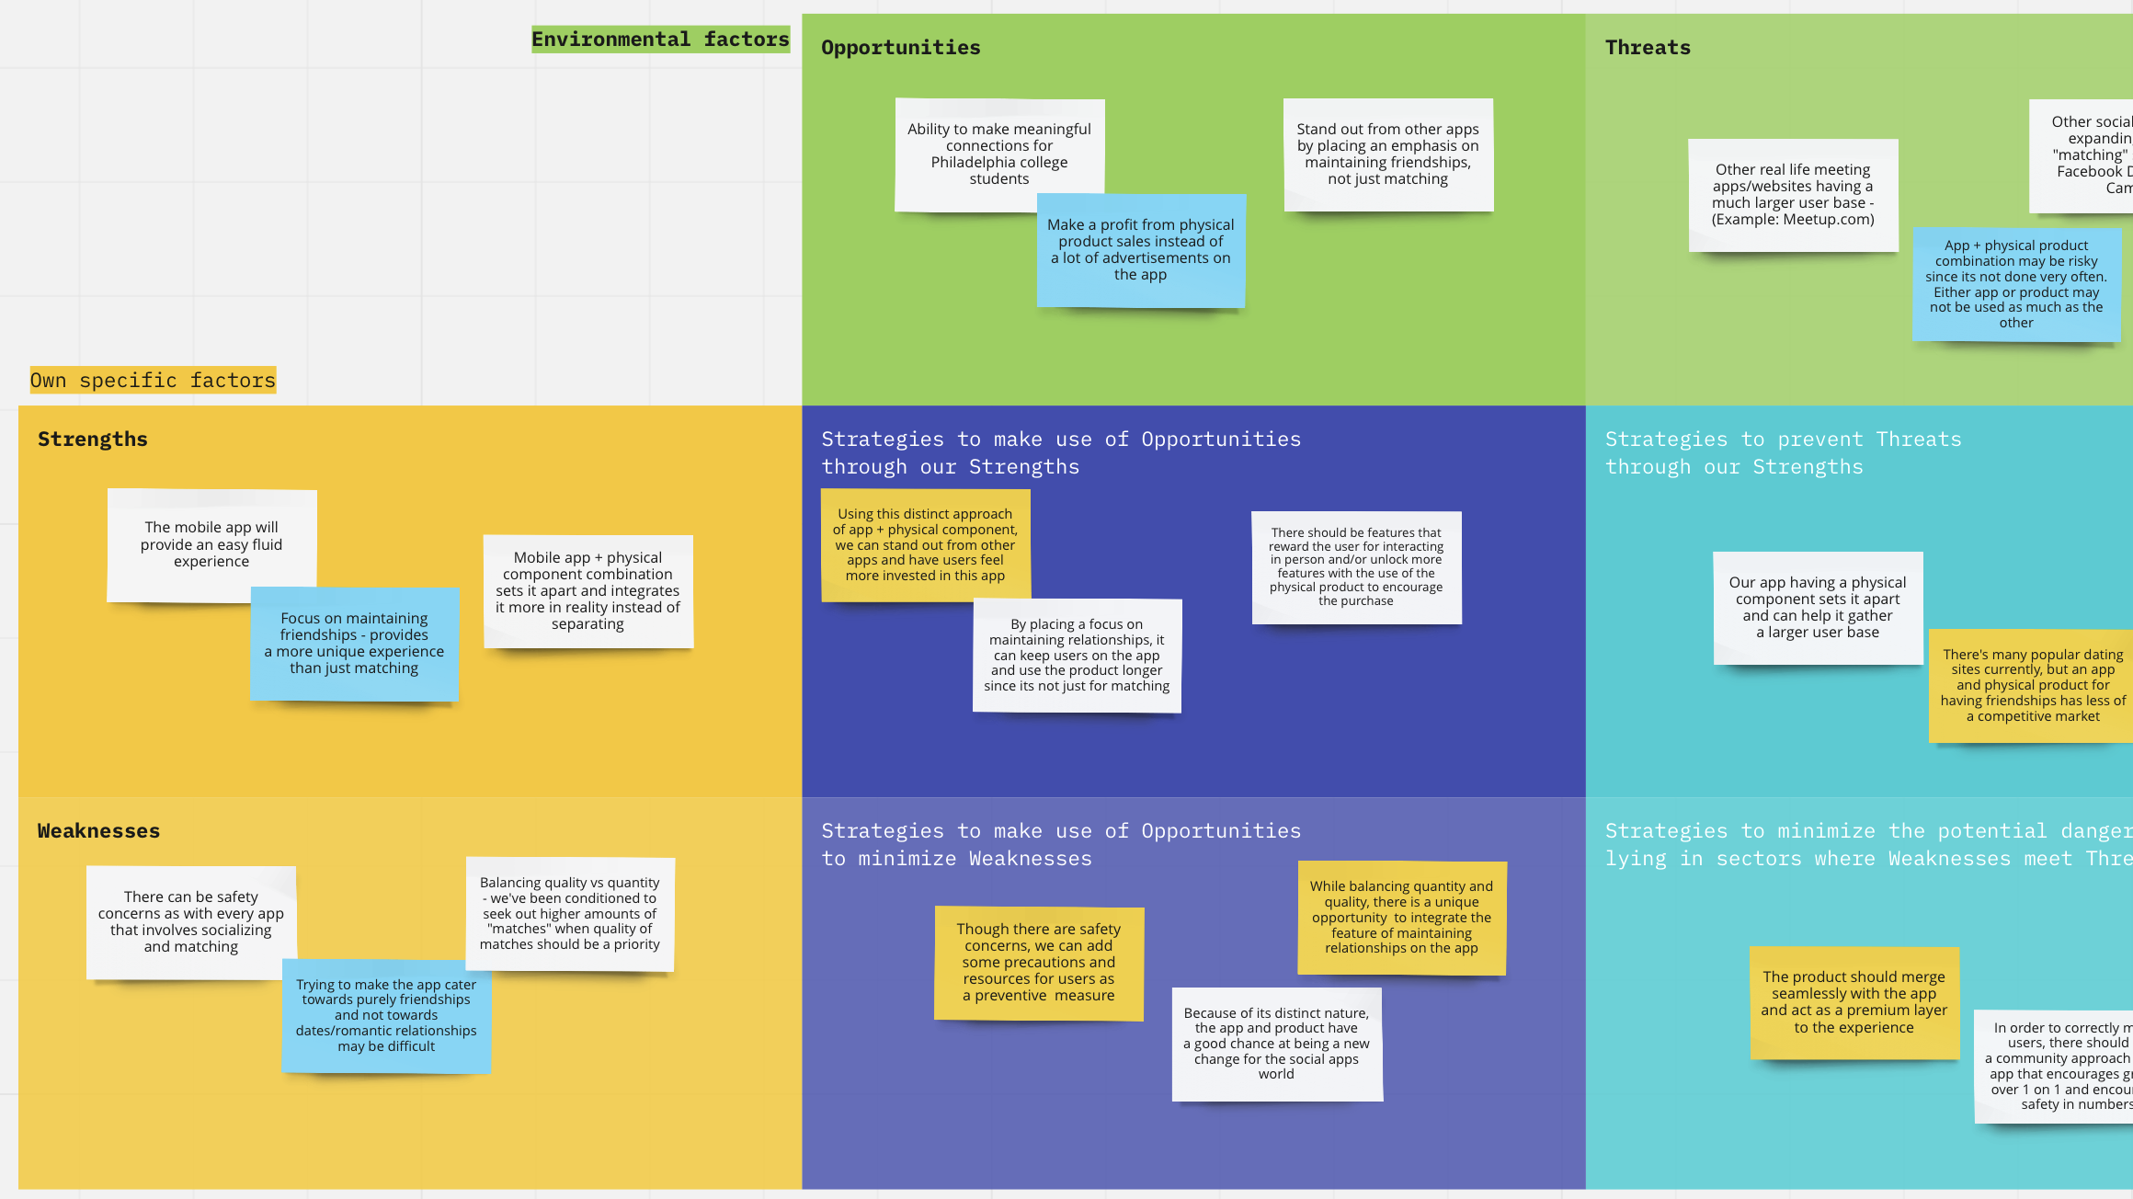
SWOT Analysis

Slide 10
Findings and Potential Features
Issues
Solutions
Trouble making acquaintances into friends?
Varying users and style?
Trouble maintaining so many friends?
Friendship booster!
Simplistic bracelet appearance
Friend reminders

Slide 11
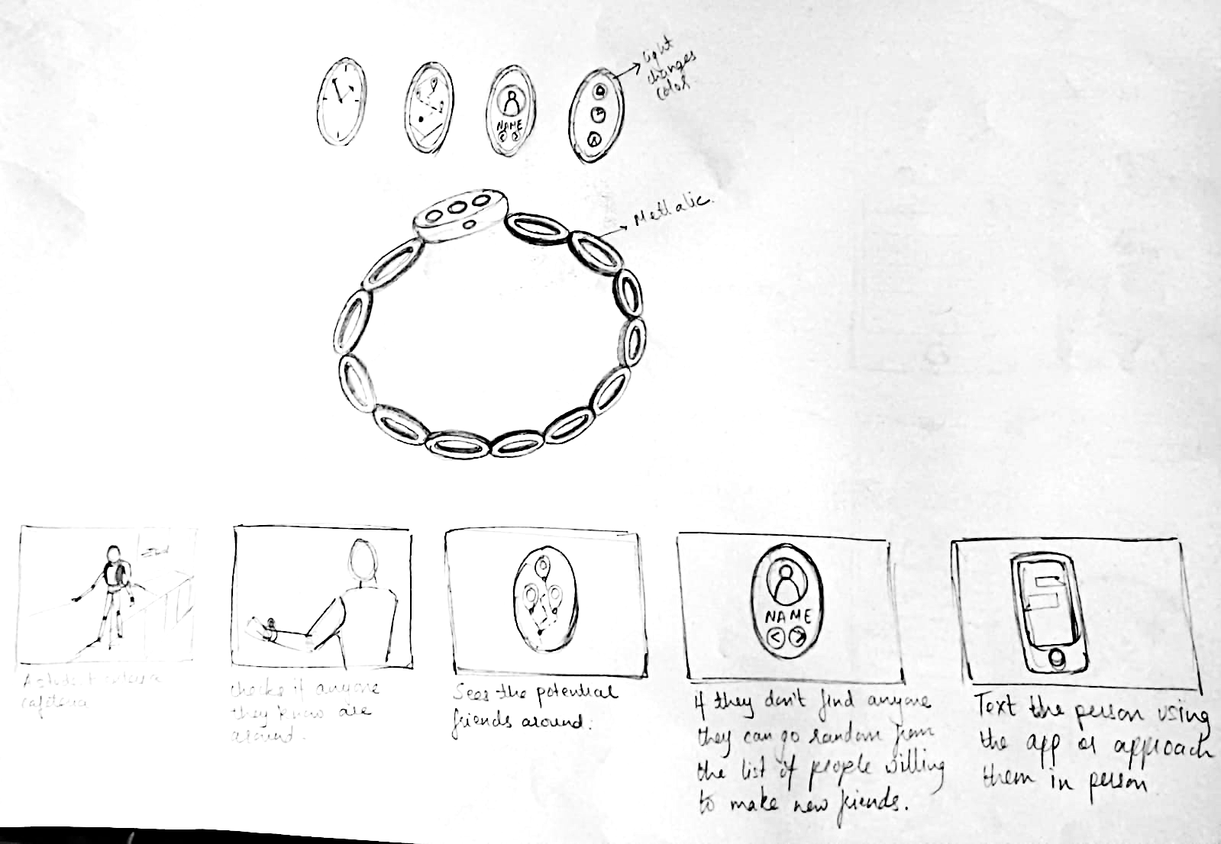
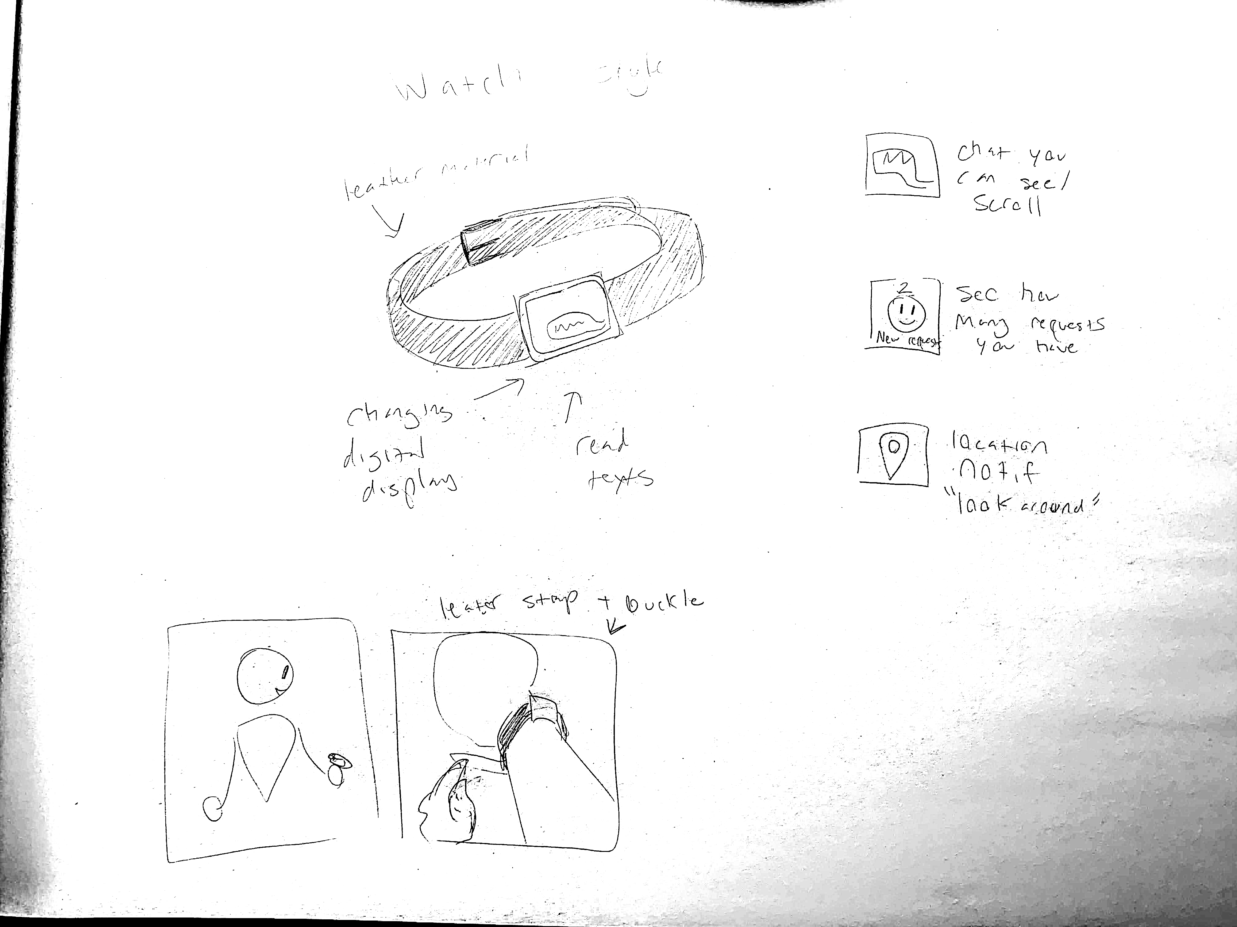
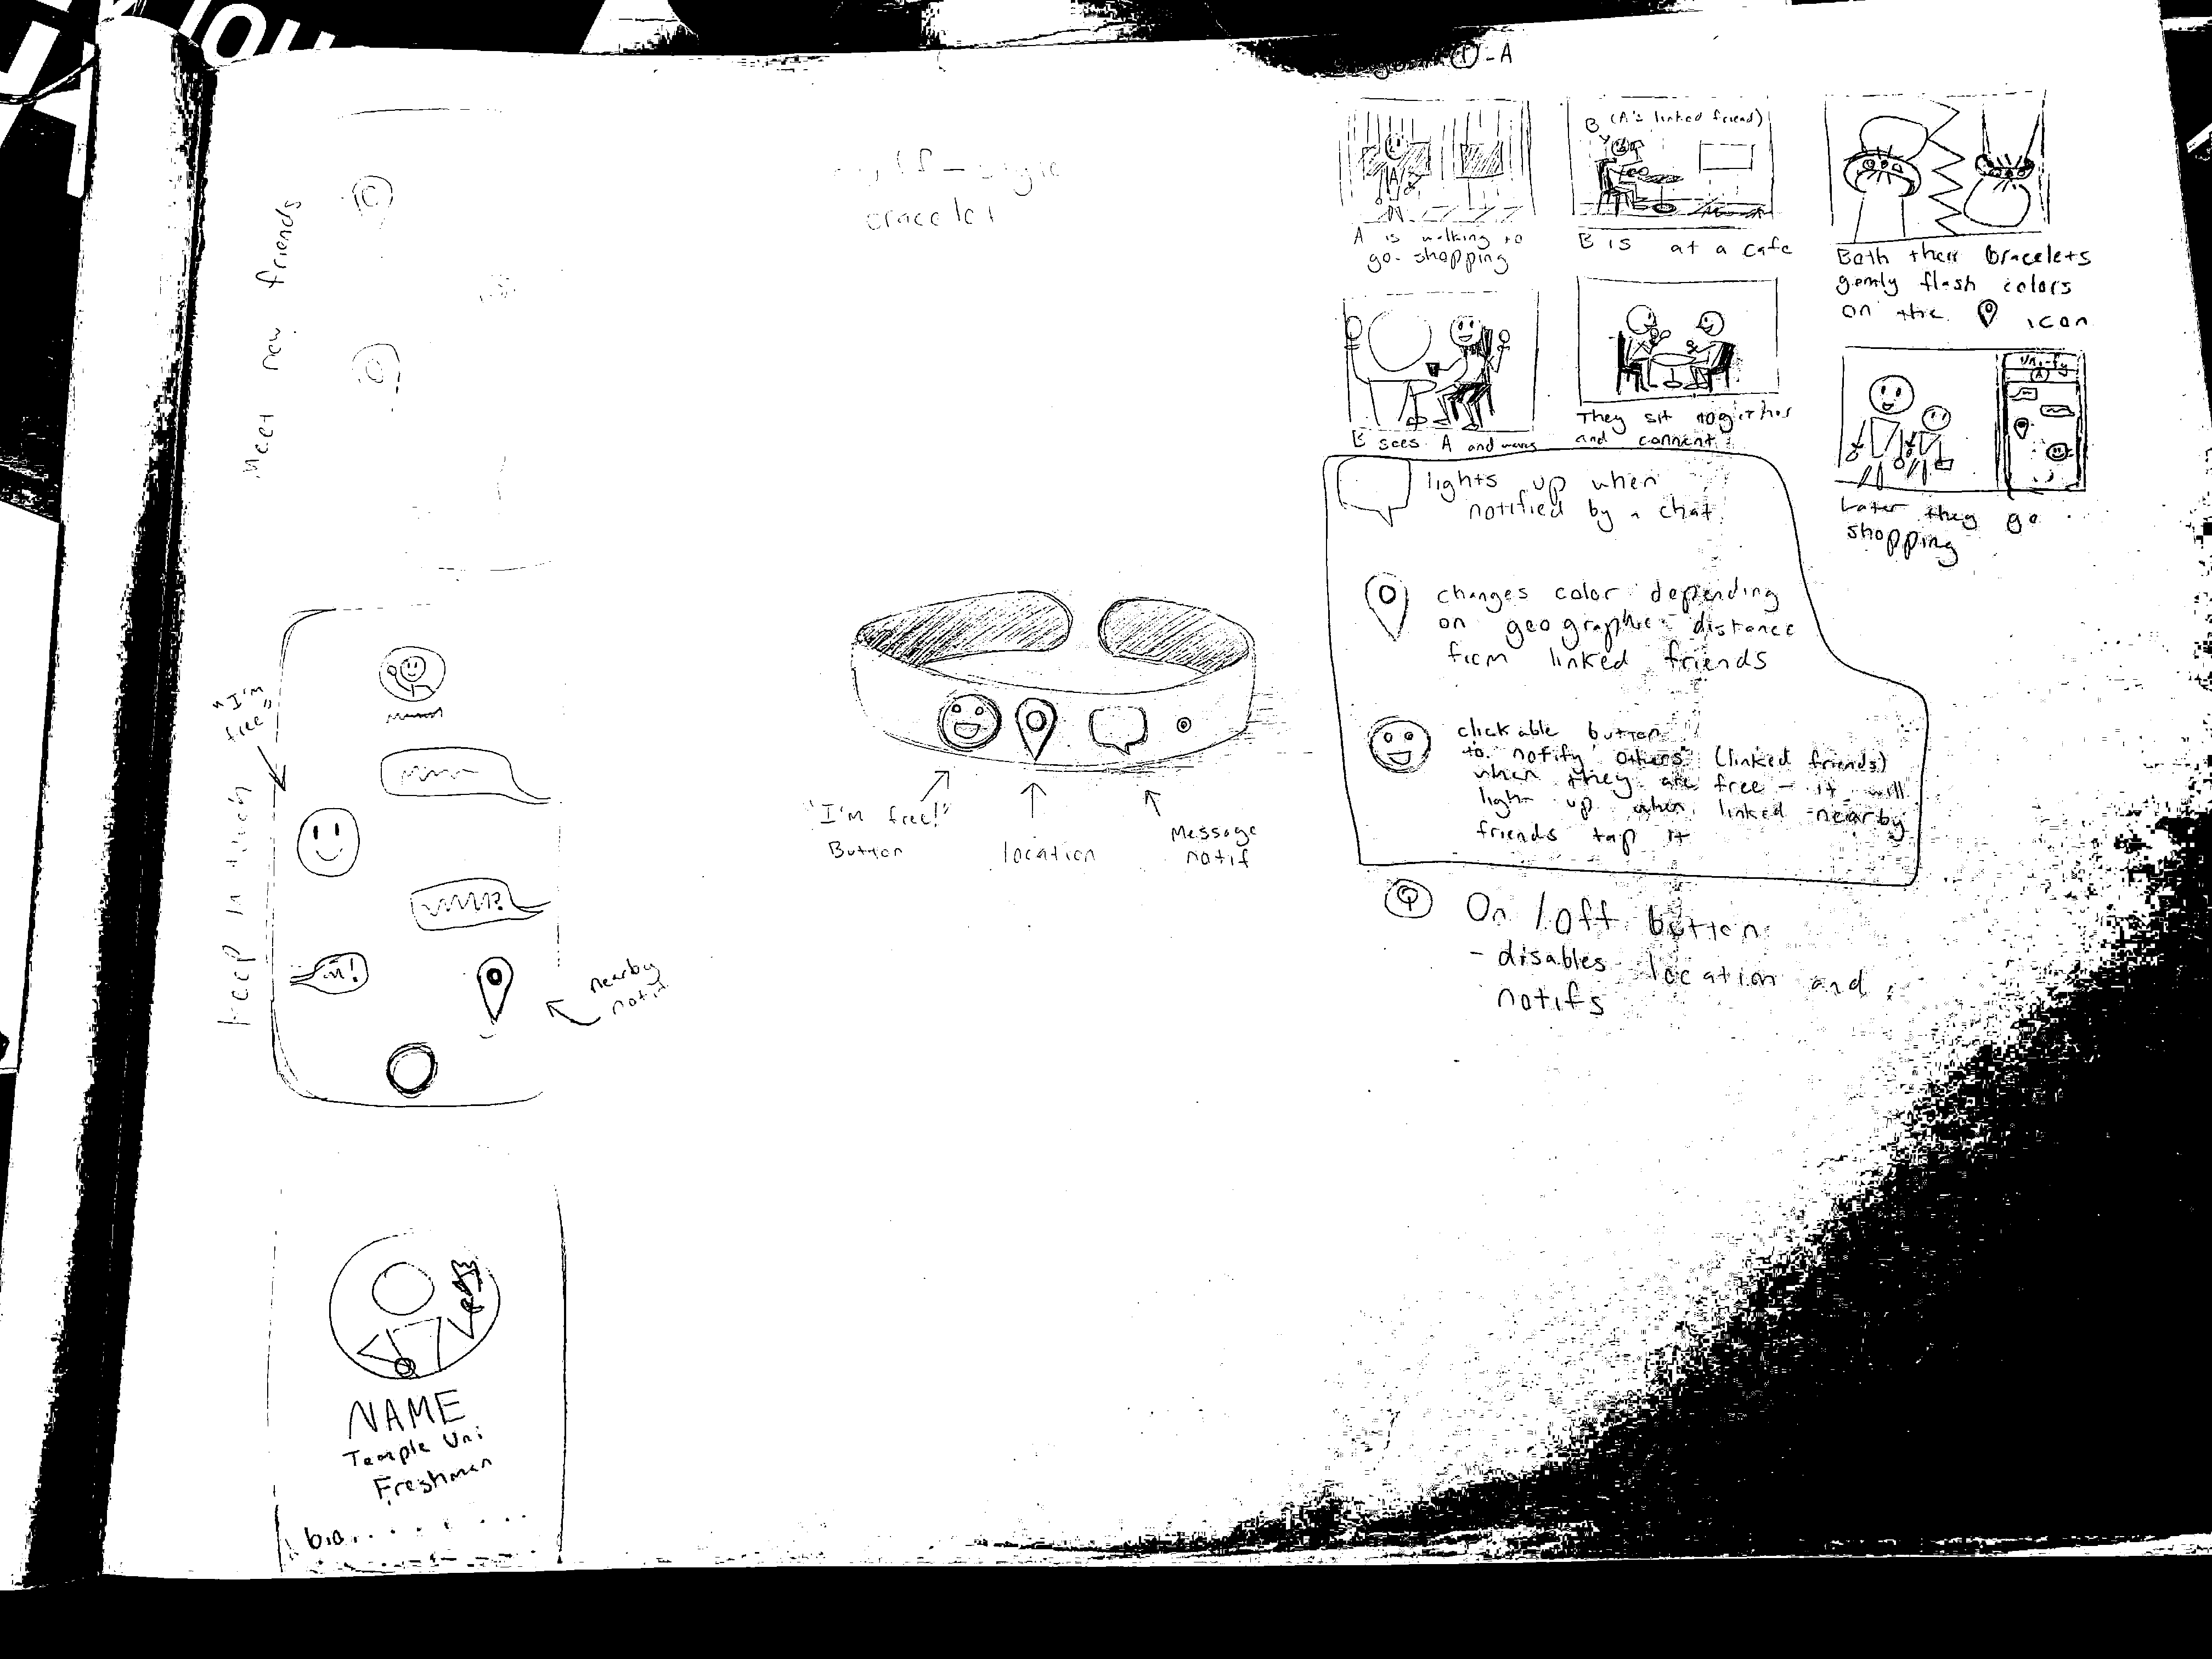
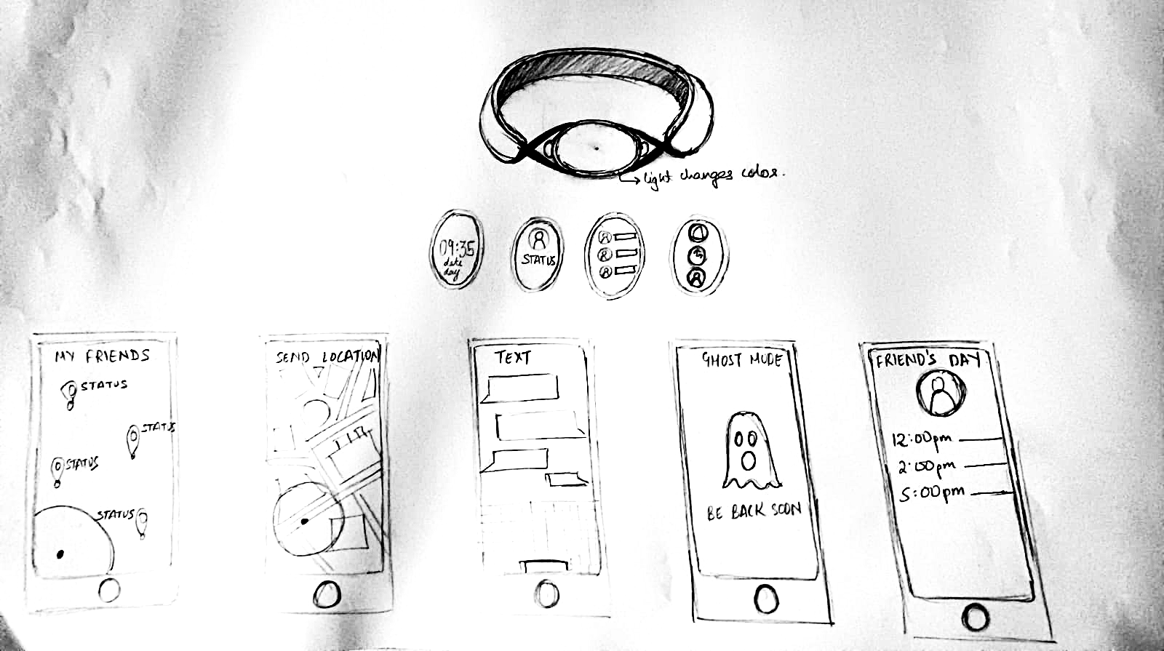
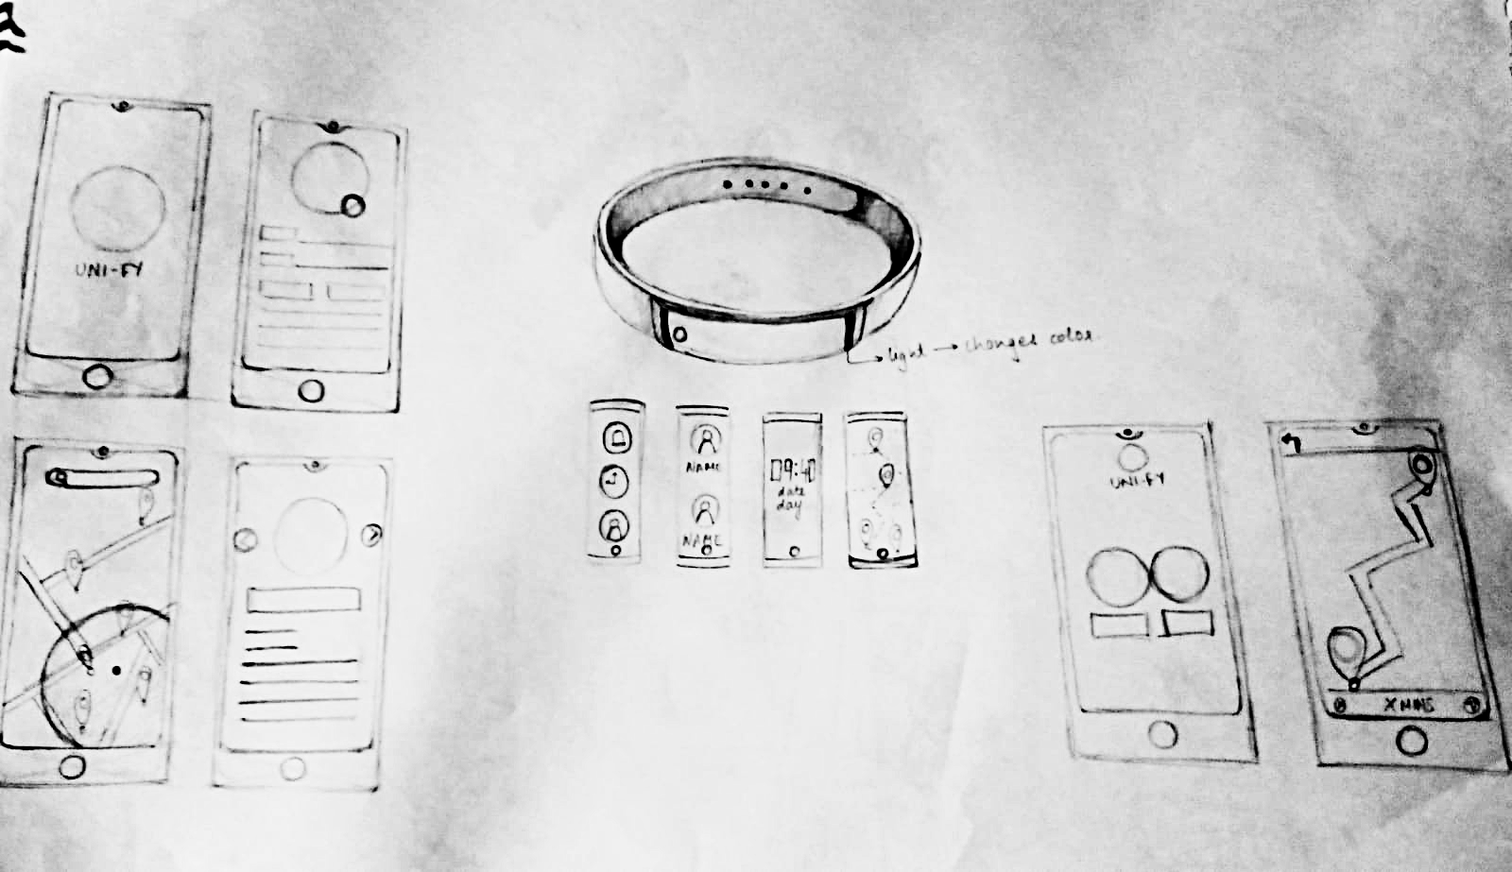
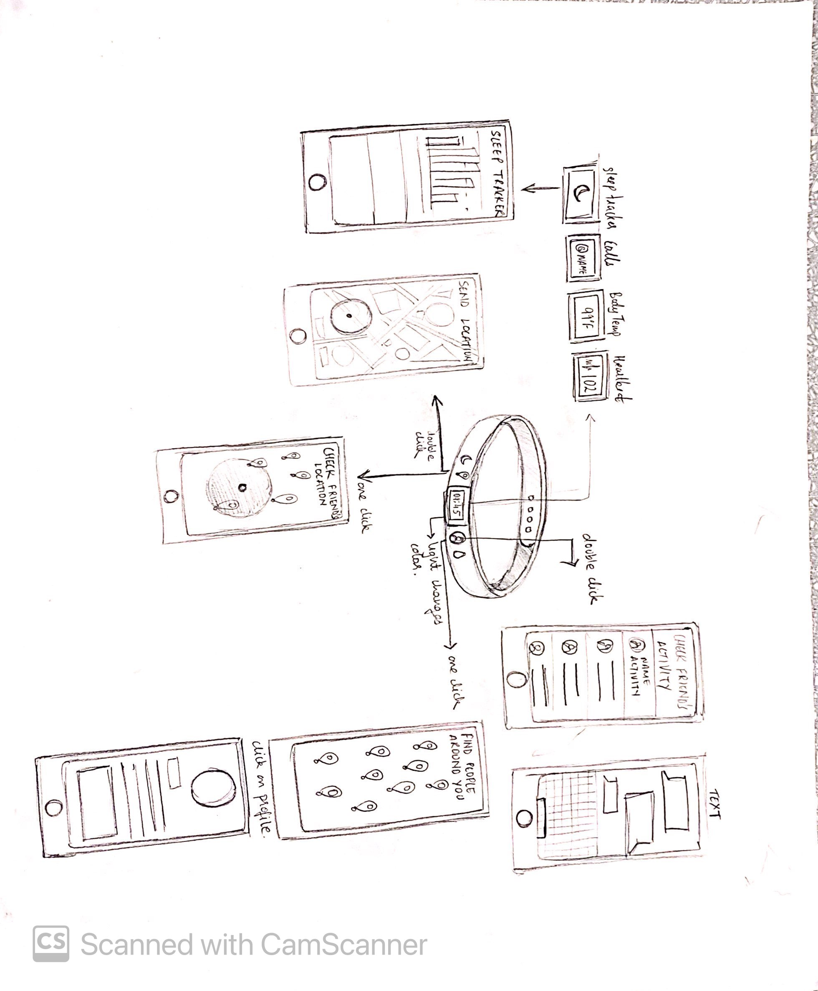
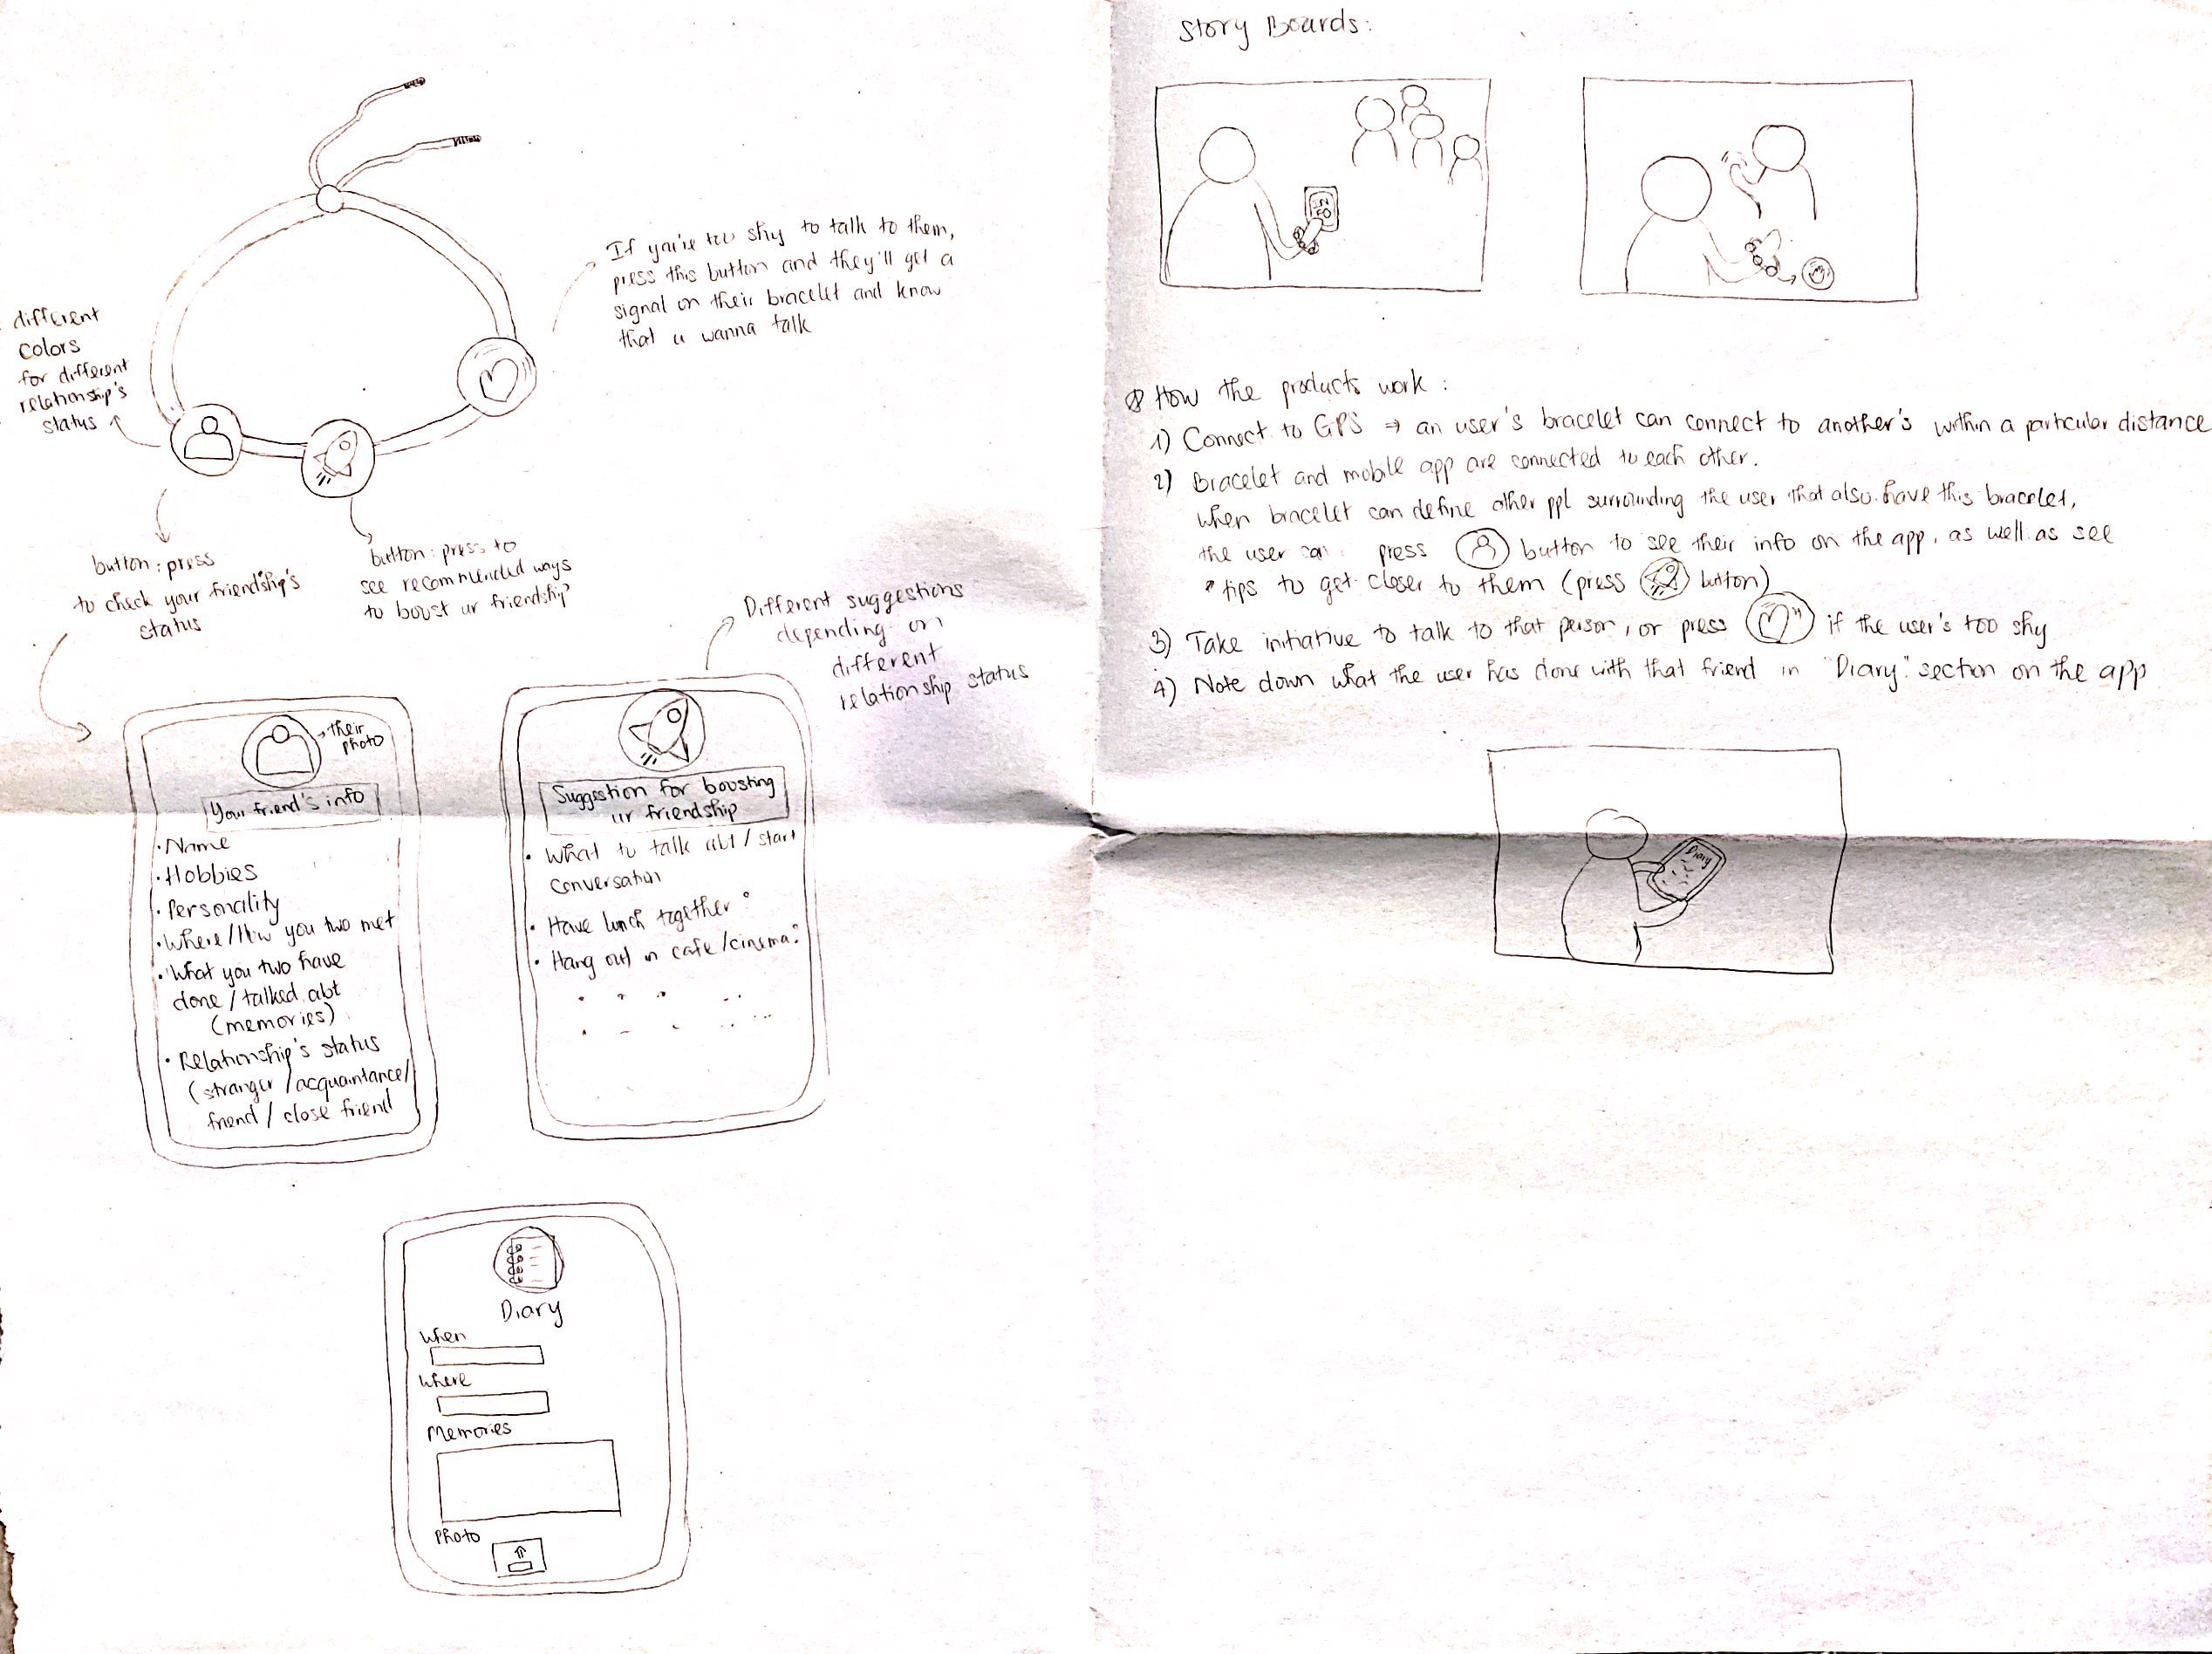
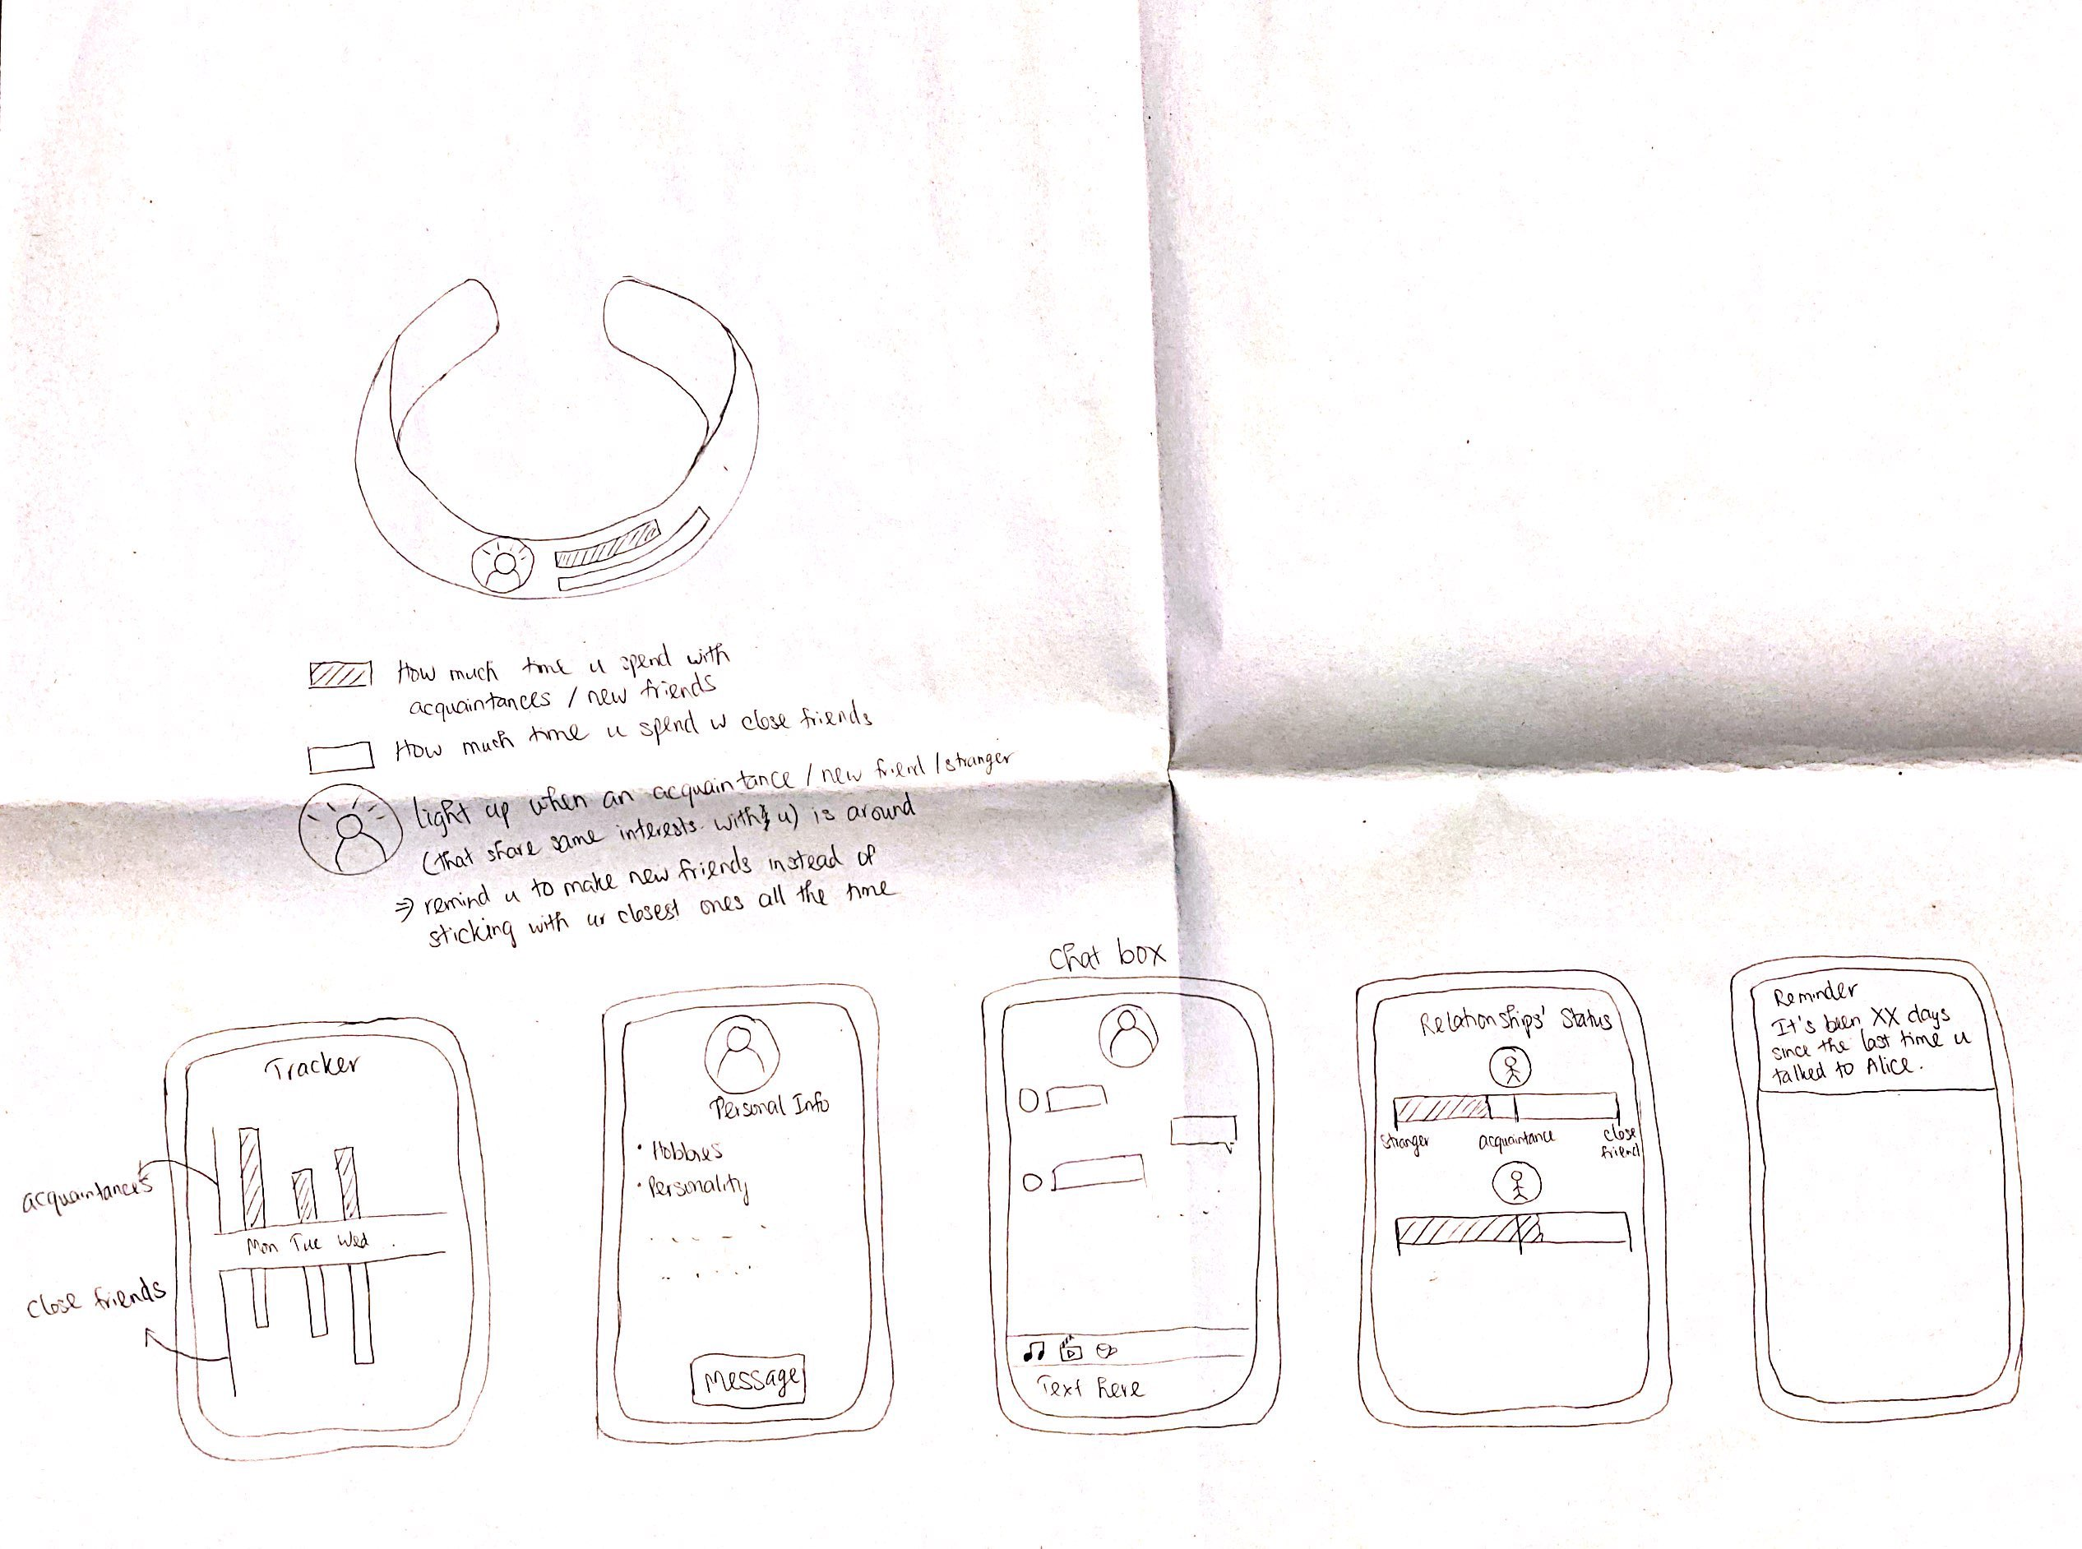

Ideations + Iterations

Slide 12
Design Statement
The Uni-Fy Bracelet is a combination of smart watch and friendship bracelet. It has GPS connection which can show you your friends’ location and profiles. The feature of the bracelet is that it can also connect to a mobile app which serves many other functions, including friends’ availability, reminder, friendship booster, friendship status, diary. It enables the users to make friends with other college students who share the same values and interests with them, and strengthen their friendships
In addition, the bracelet can display time and date, estimate your body temperature and heartbeat, show sleep tracker, and hydration tracker as every other smart watch.

Slide 13
Final Design - Bracelet
Bracelet Functions
Sleep tracker – how long/quality of sleep
Water tracker – when to drink more water, amount of water consumed
Time displayed
Friendship functionalities
Send location feature
Check friend activity
Vitals –
Body Temperature
Heartbeat

Slide 14
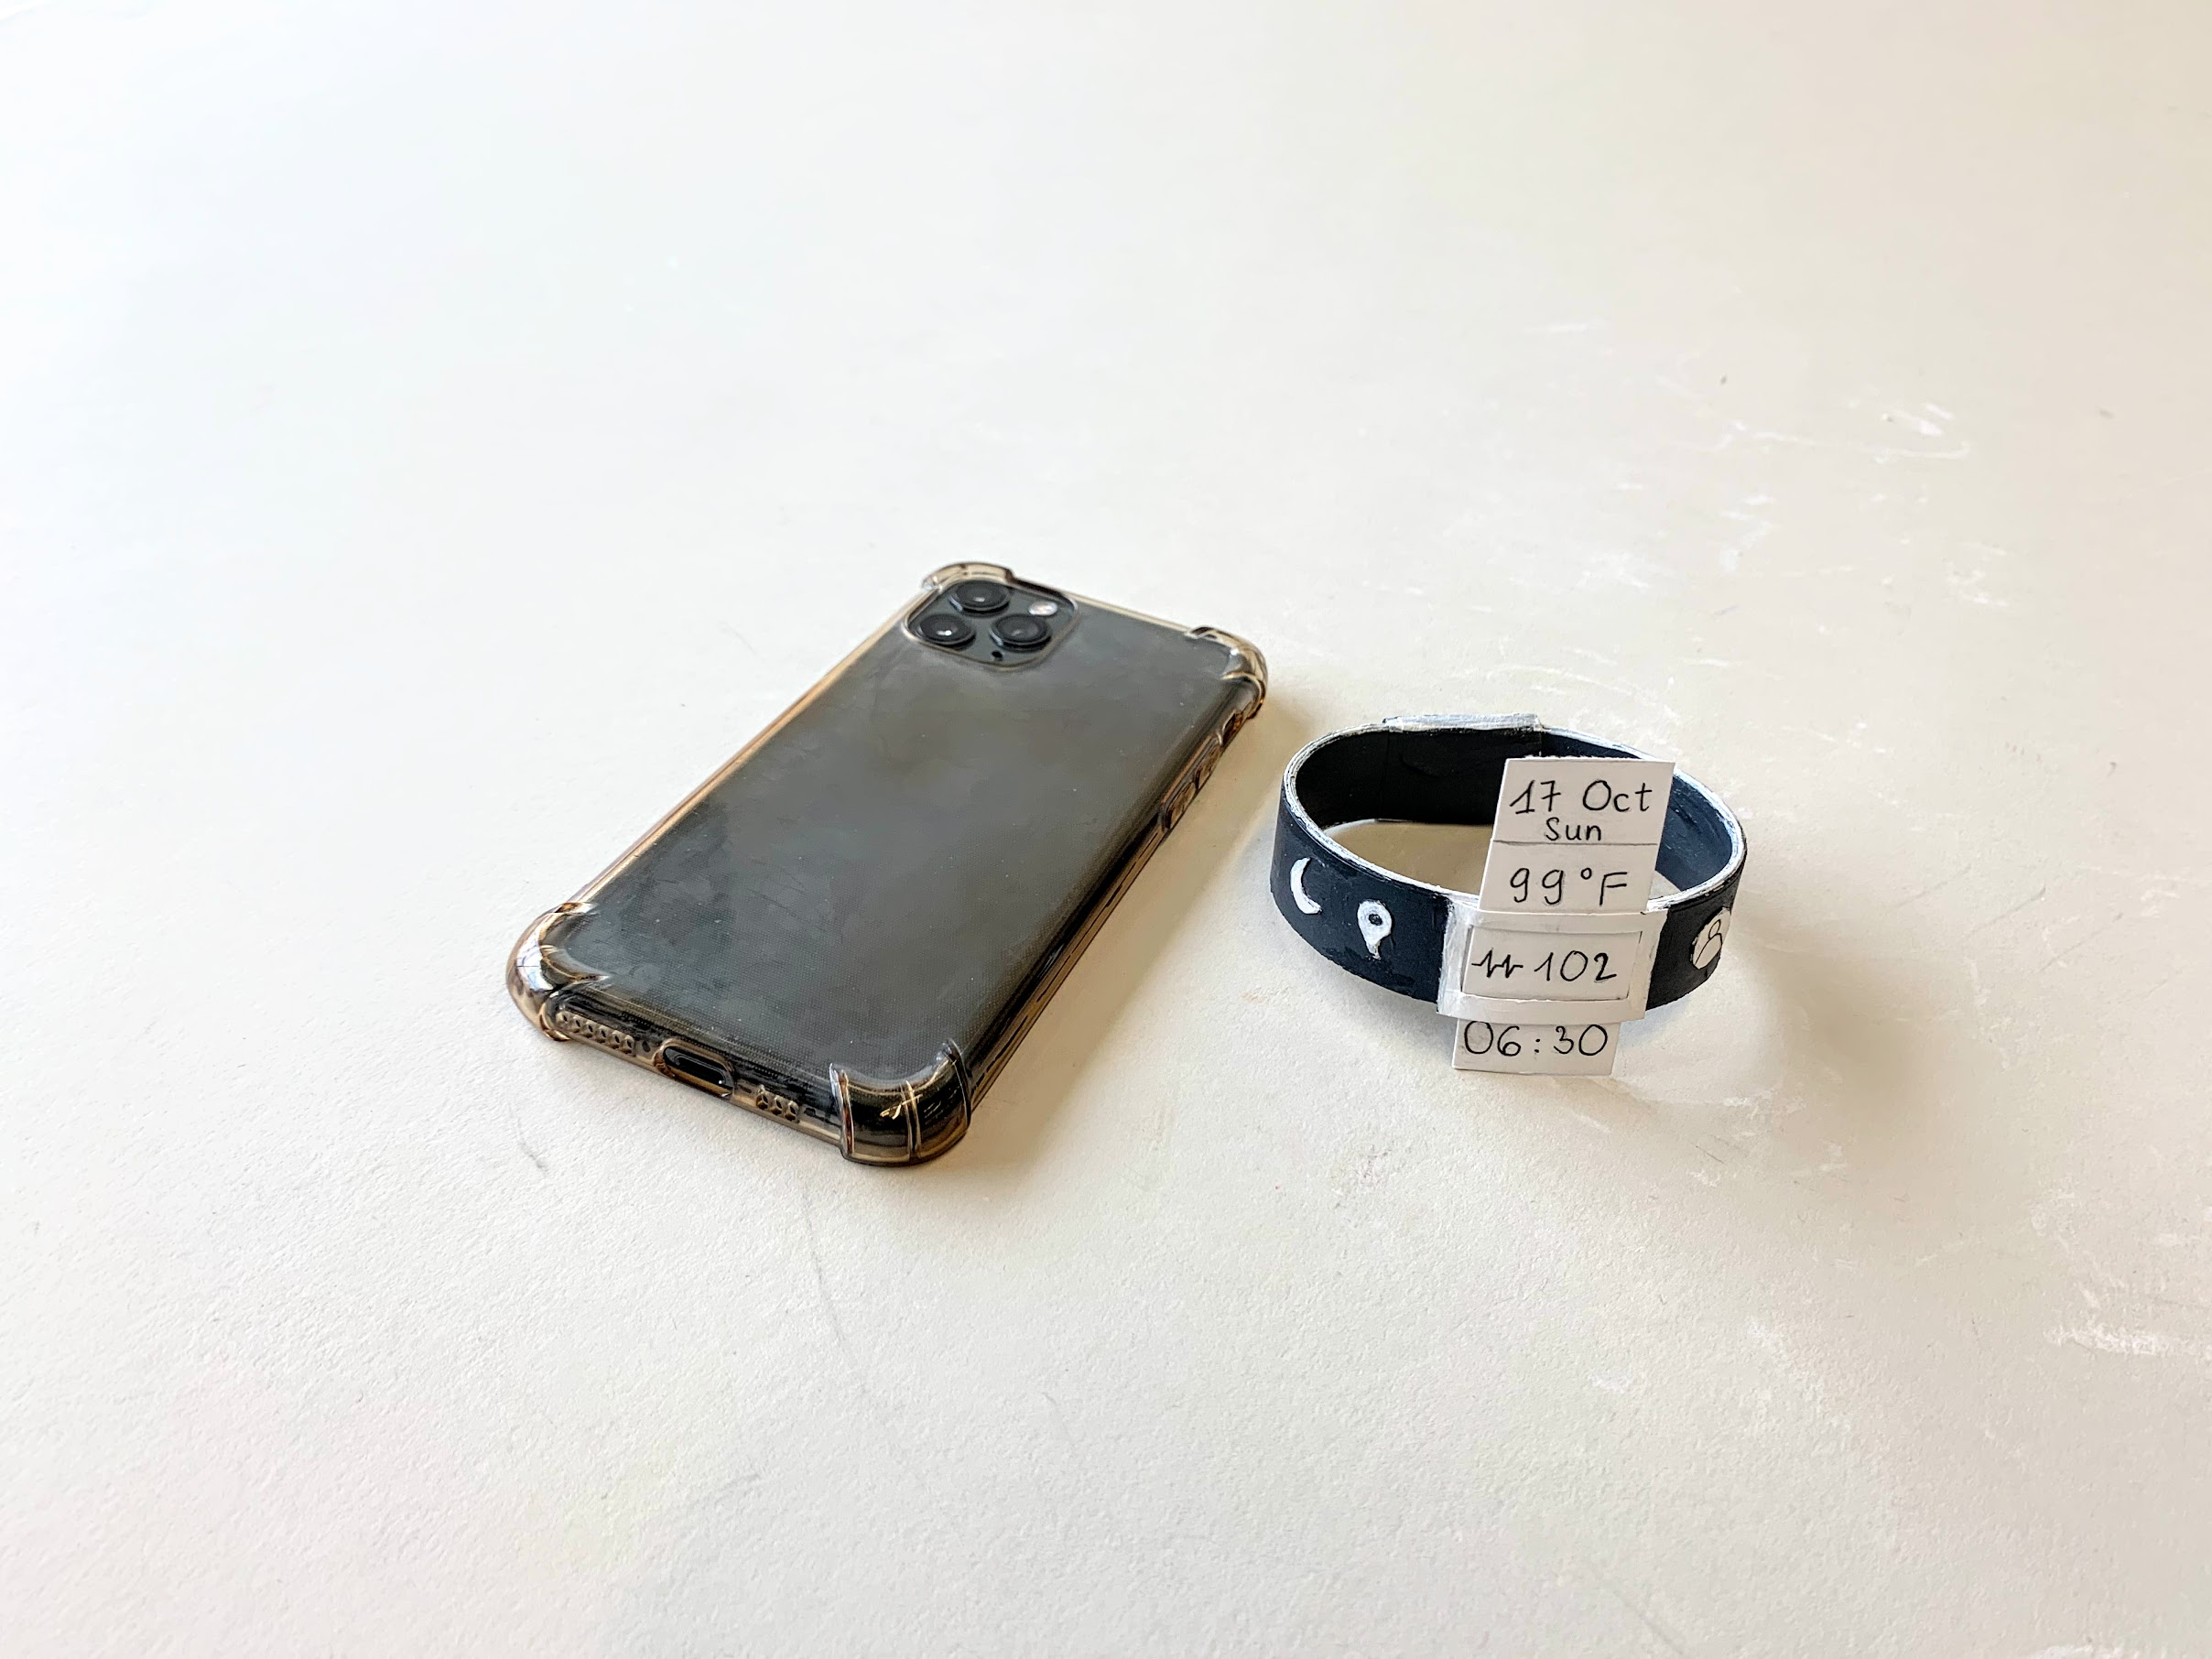
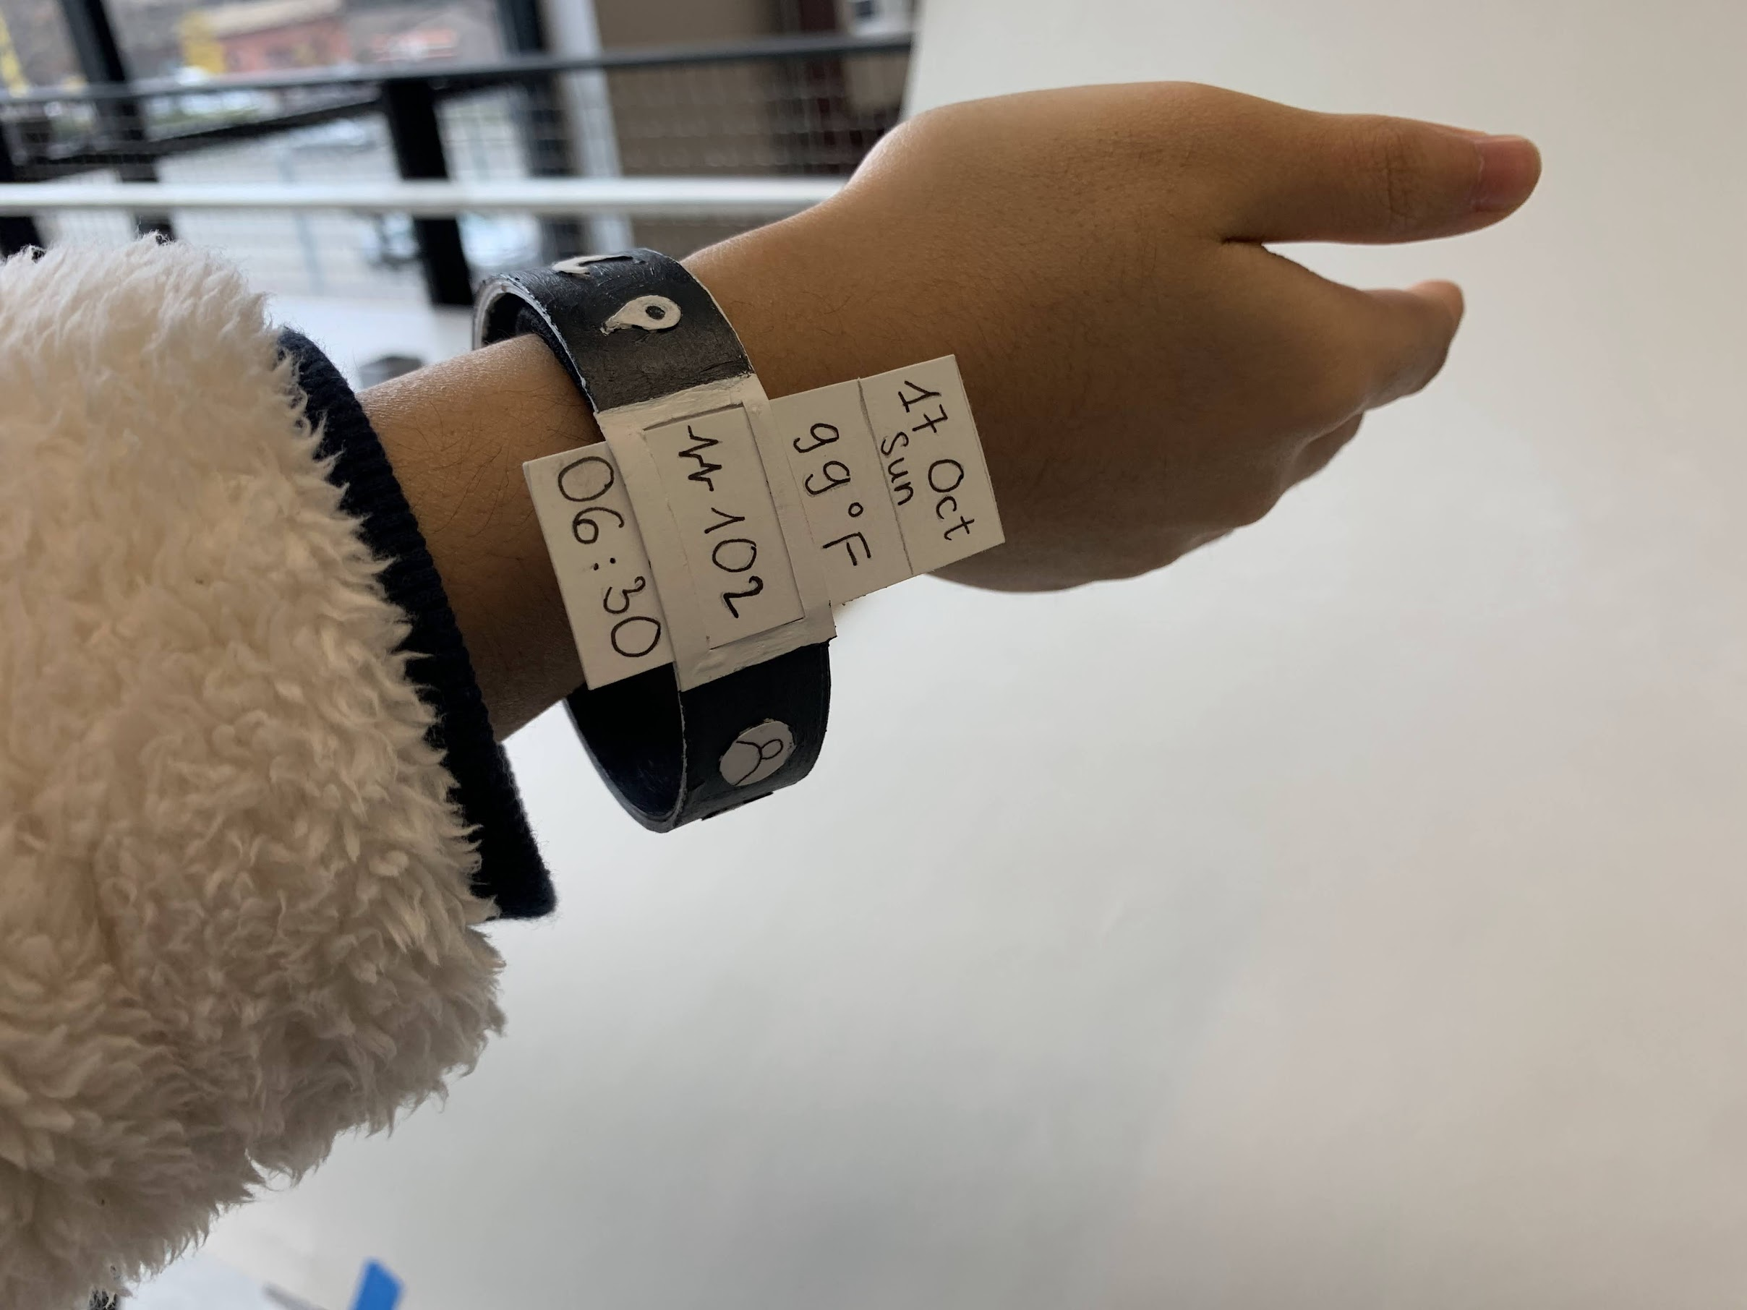
Final design
Easily click icons to navigate directly to the app
Swipe the screen to navigate to different features
All in one, minimalistic band
Customizable features ( sleep tracker + water tracker )
Water resistant and sweat resistant material
Battery operated – no need to charge
Available in multiple band colors

Slide 15
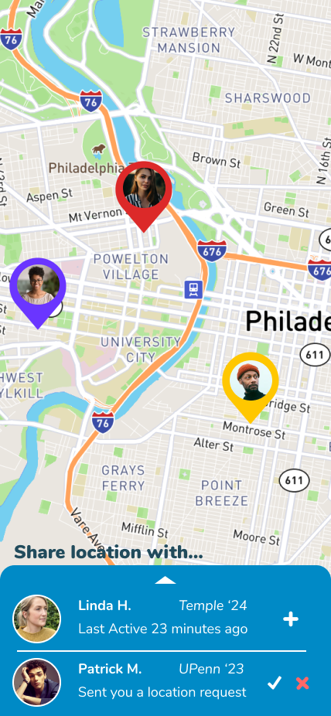
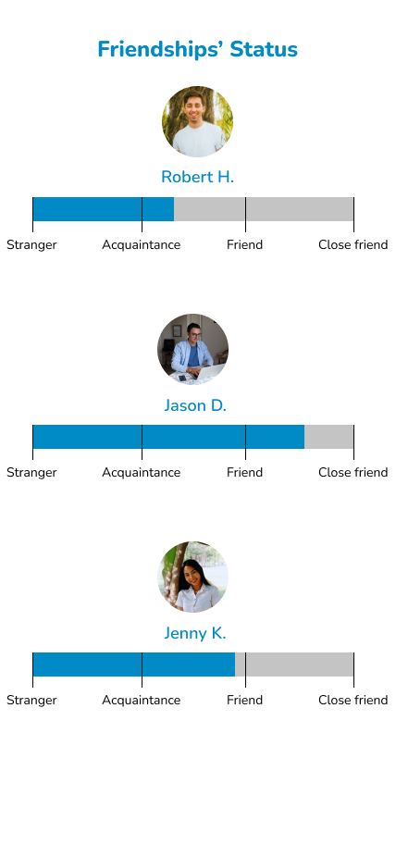
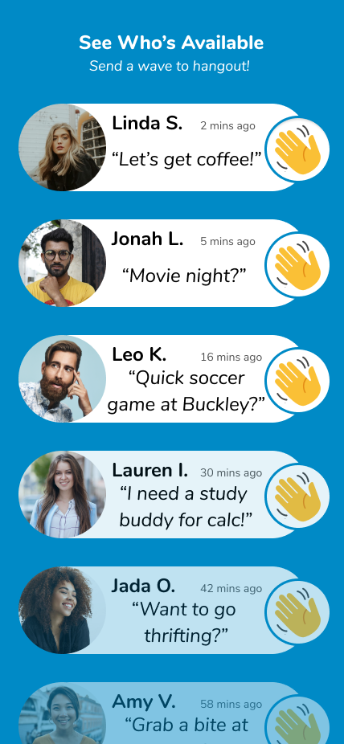
App Functions
Location
See where your friends are
Friendship status
See how much time you’ve been spending with friends, how close to them you are
Friend’s availability
See when your friends are available and want to hang out

Slide 16
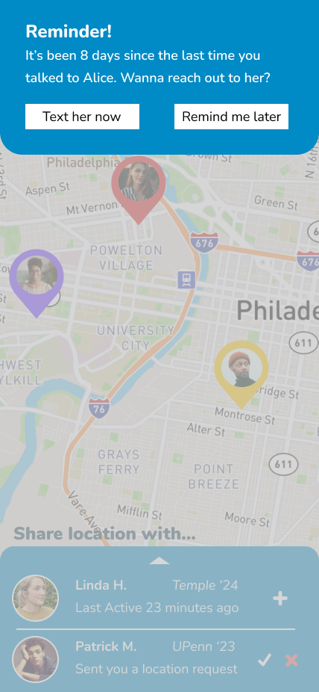
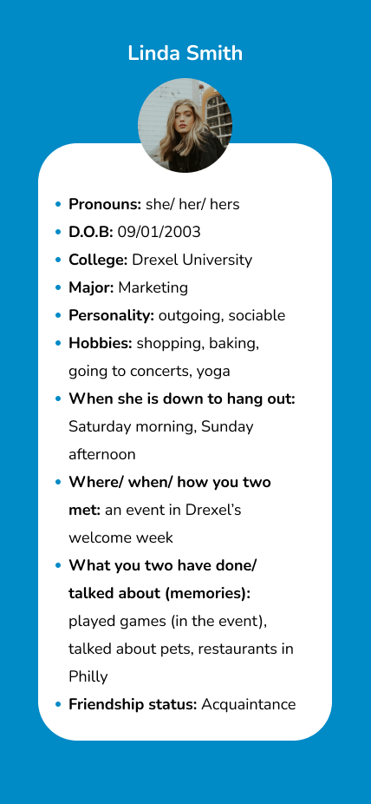
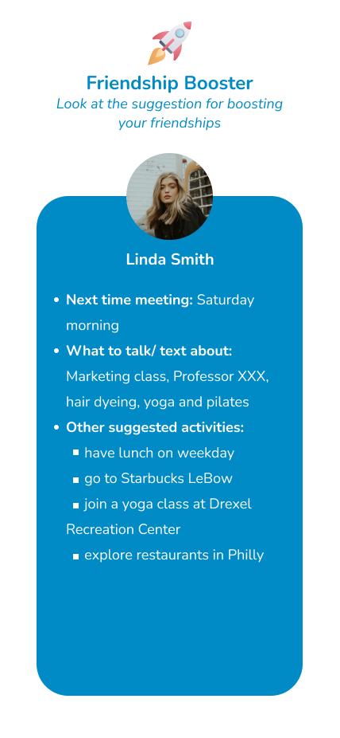
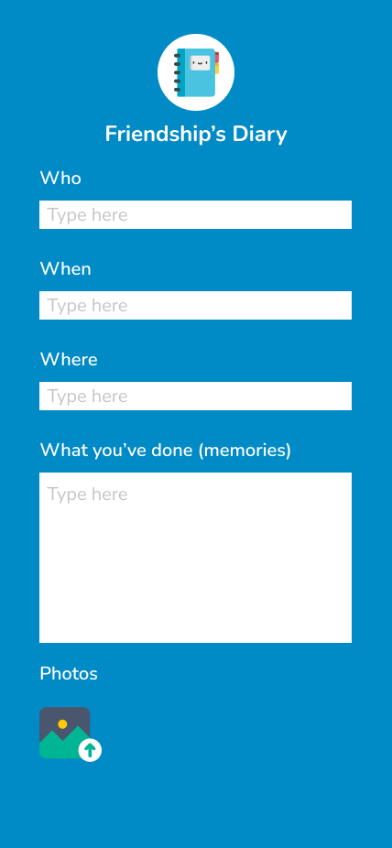
App Functions
Friends' profiles
See people's bios, hobbies, and how you get to know them
Friendship booster
See some advices on how to maintain your friendships
Friendship's diary
Note down memories you have with your friends (this will help the app develop the Friendship Booster)
Reminder
Remind you if you haven't connected to a friend for a period of time

Slide 17
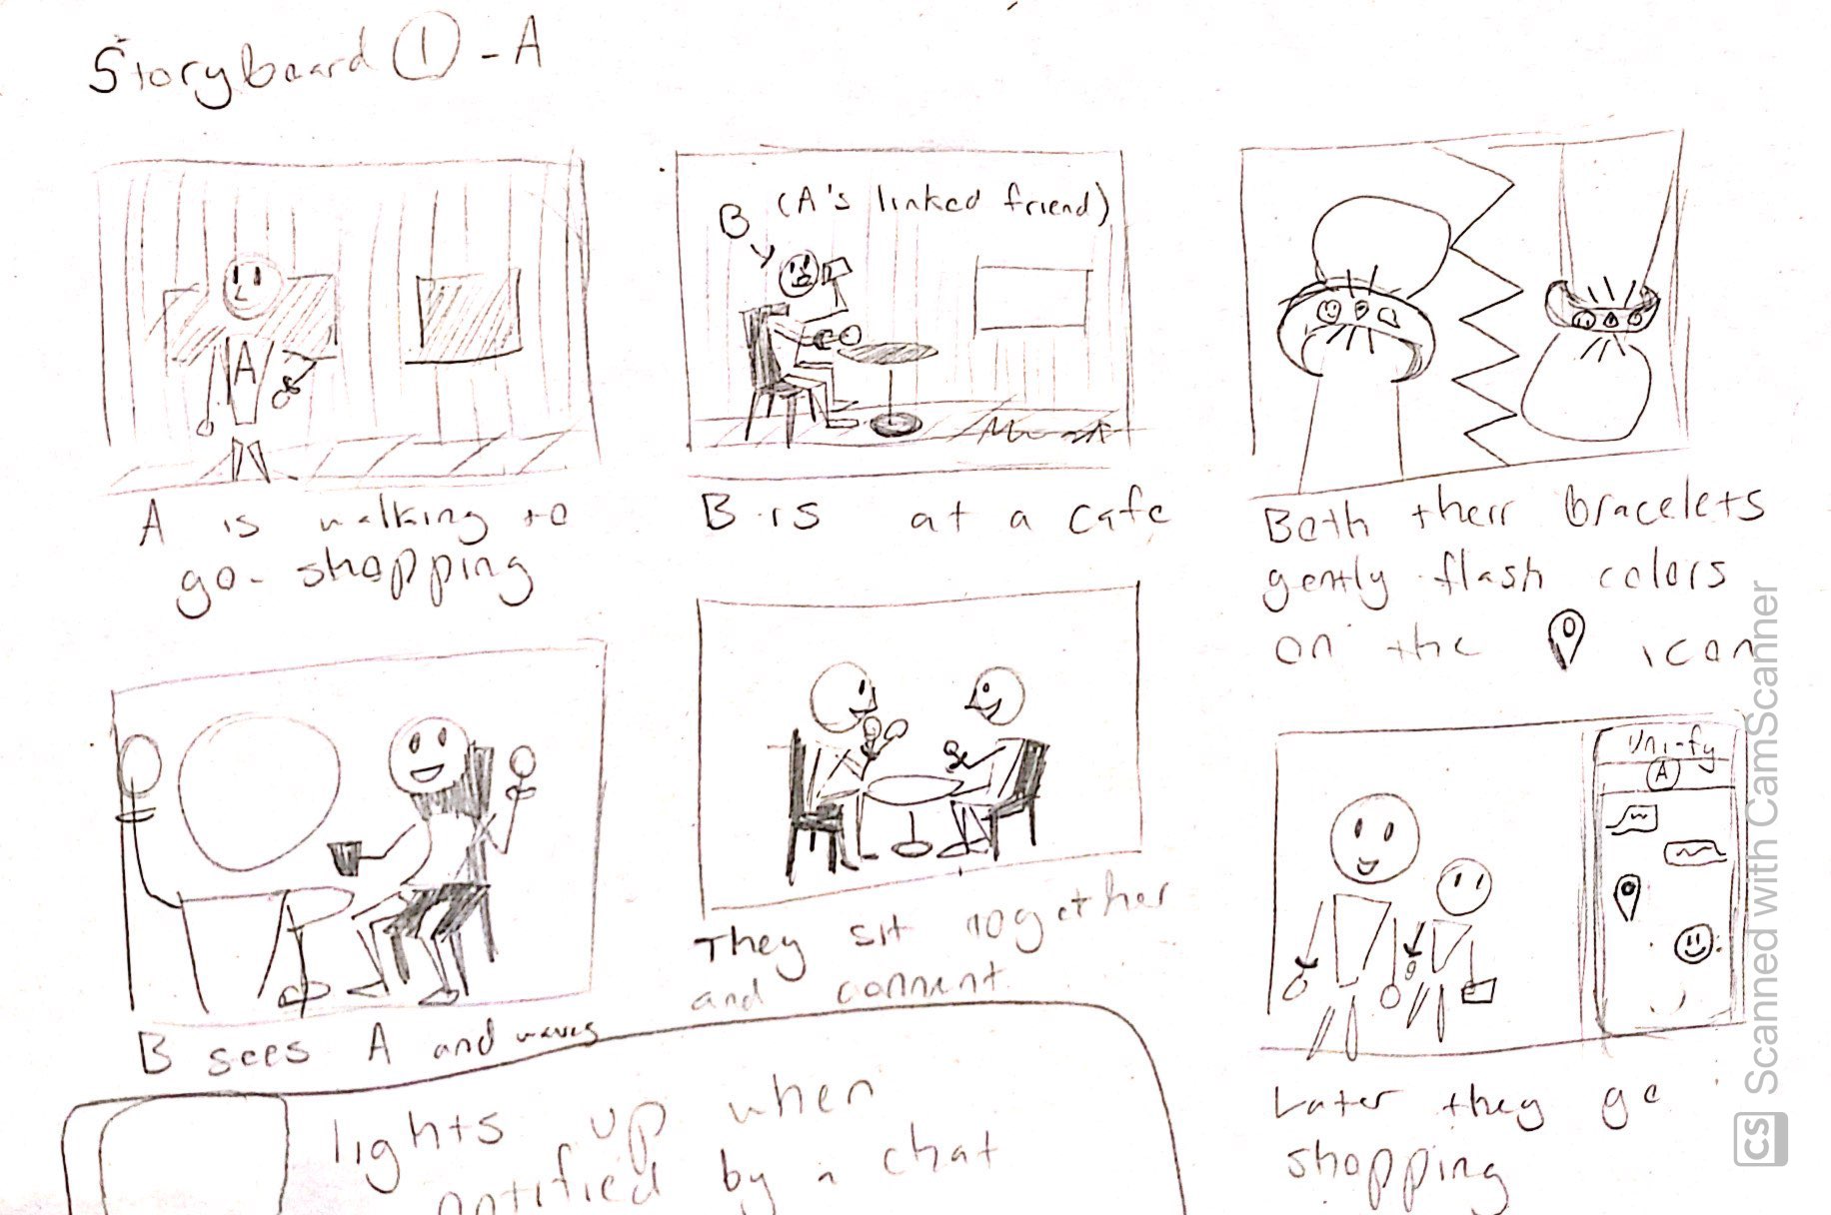
Storyboard

Slide 18
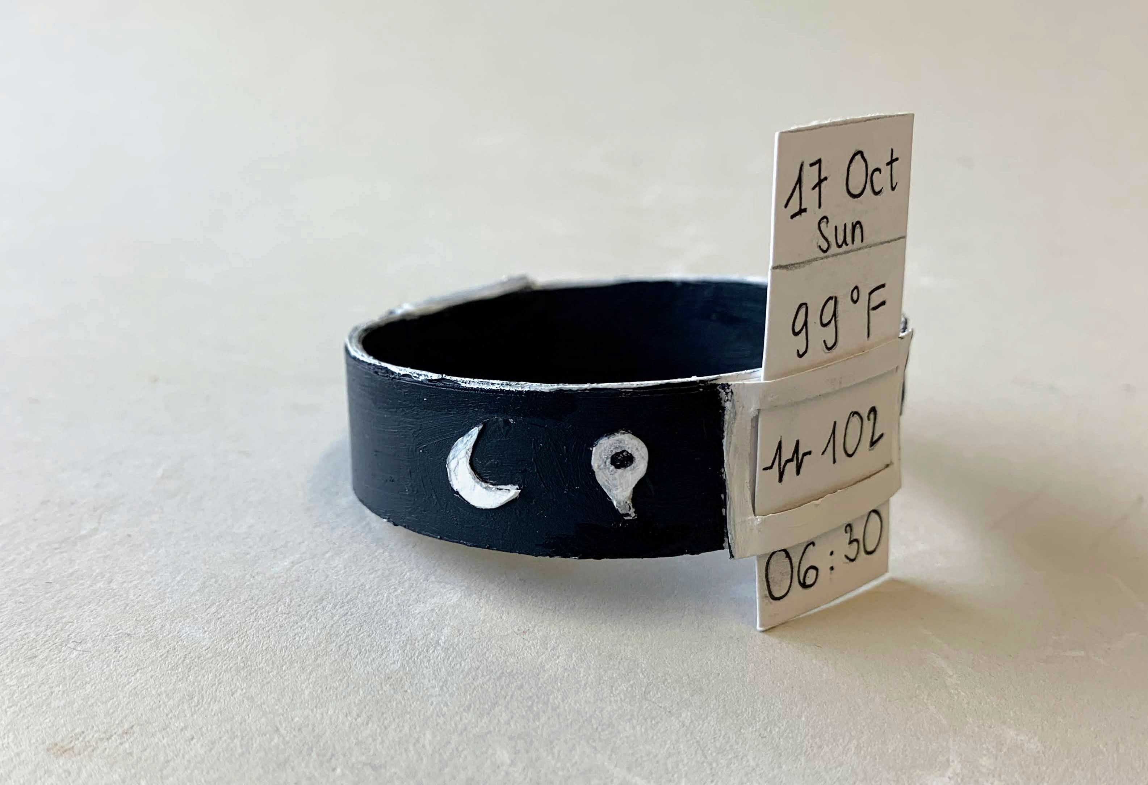
Prototyping Plan
For the bracelet
Cut out bristol paper into strips of paper and glue them to make a thicker one
Bend it to create a circle and fix two ends of the strip with tape
Cut out icons for the buttons on the bracelet
Paint the bracelet with acrylic paint
For the app
Design the app's interface on Figma, each function of the app is displayed on a particular frame

Slide 19
Testing Plan
Let some students wear the bracelet and ask them to explain the function of each button on it
Do the same thing with app interface
Ask them if they are confused of how to use the products or if they have any suggestions for their design/ functions
Continue to improve our prototype and do the testing again

Slide 20
Marketing
Advertising + Purchasing

Slide 21
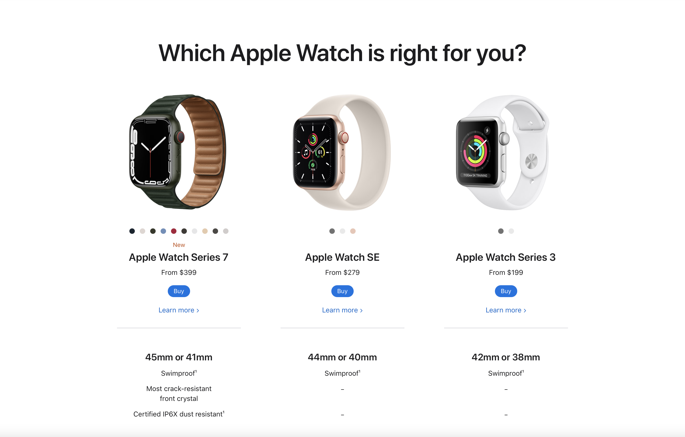
Market Research
Apple Watch
Features
Time
Messaging
Vitals
Paired with an iPhone
Price: $199-$399

Slide 22
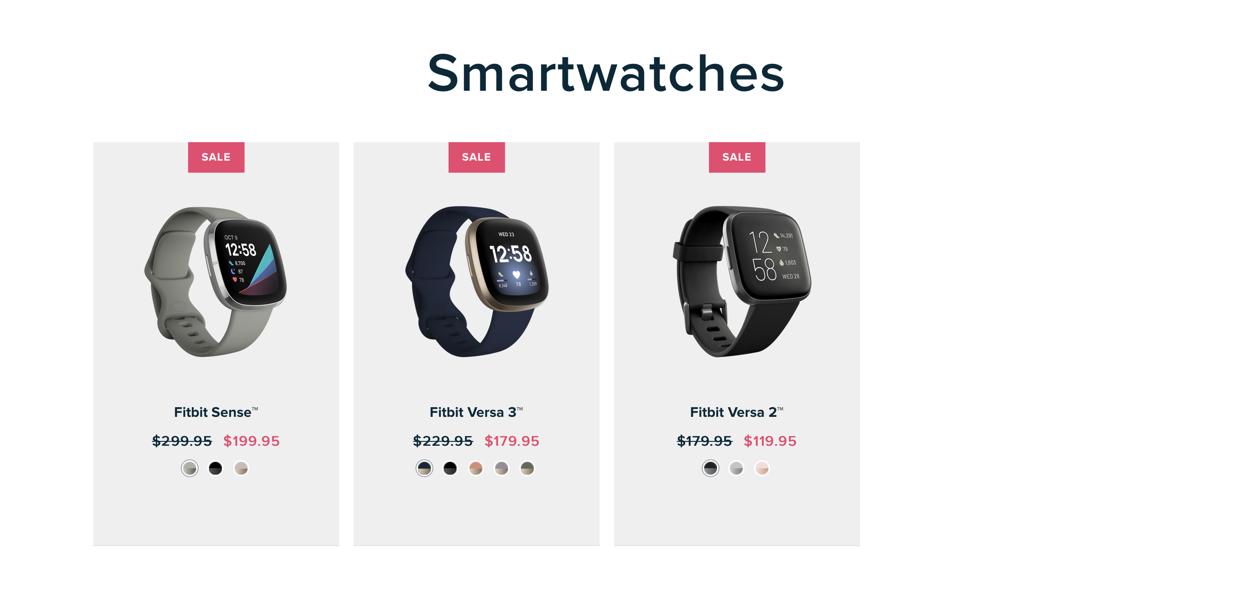
Market Research Continued
Fitbit Smartwatch
Features
Time
Personalized Data
Extensive Health Vitals
Reg. Price: $179-$299

Slide 23
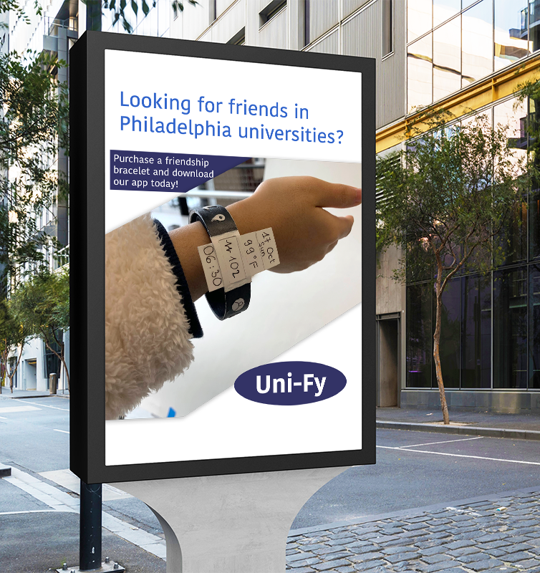
Advertising
In or near Drexel, University of Pennsylvania, Temple, and other Philadelphia college campuses
High traffic areas such as Market Street
Online ads on Instagram, seen by users in geographical Philadelphia region, aged 18-22

Slide 24
Purchasing
App
Bracelet
Available for free
Located on the app store for iPhone users
Located on the Google Play Store for Android users
Available for $149.99
Located at Barnes & Noble, (college-specific bookstores)
Online on Amazon and the official Uni-Fy website and app

